Slide 1





Secondary metabolites: paths to discovery
Sandra Godinho Silva
sandragodinhosilva@tecnico.ulisboa.pt
28 April 2021
Notes:
1

Slide 2
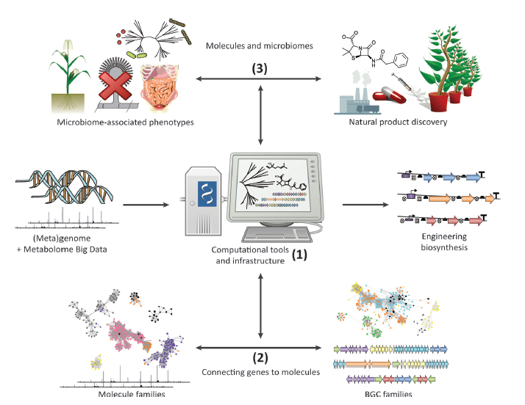
Natural Products Discovery
Why is this still a relevant field?
Rise of multidrug-resistant pathogens
Acute and long-term side effects of widely used drugs
Urgent need for
new therapeutic agents
+
=
Harvey, A. L. 2008. “Natural products in drug discovery.” Drug Discovery Today, 13(19–20), 894–901.
Notes:
solve the current problems with drug resistant pathogens
obtain improved chemotherapy agents with reduced side effects
Pharmaceutical discovery pipelines → not been delivering the amount of new drugs
2

Slide 3
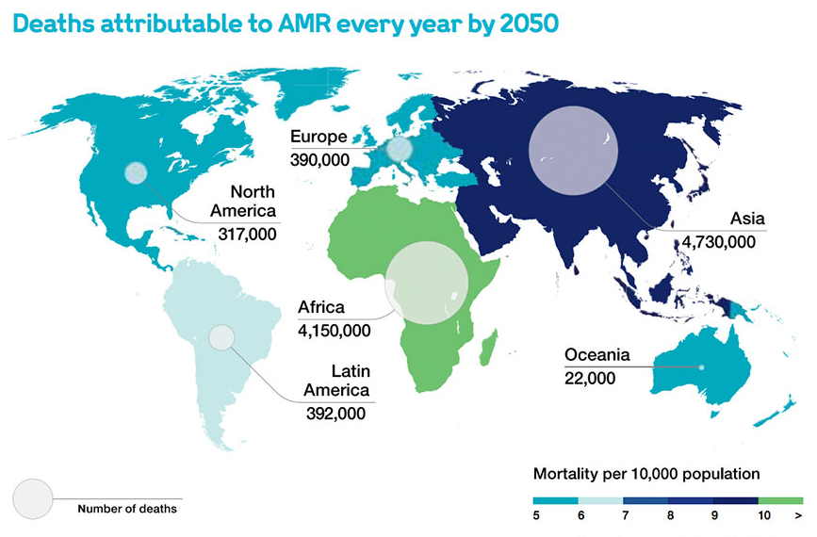
Natural Products Discovery
Antibiotic resistance accounts for at least 50,000 deaths each year in Europe and the US.
It is predicted that drug resistant infections will be responsible for the deaths of 10 million people worldwide by 2050.
Cancer is a leading cause of death worldwide with 7.6 million deaths each year with numbers continuously rising.
Source: Antimicrobial Resistance: Tackling a Crisis for the Health and Wealth of Nations (2014)
The need for new therapeutical drugs is real
Notes:
3

Slide 4
Natural Products Discovery
Small organic molecules produced by living organisms;
Normally are secondary metabolites:
Not essential for growth and reproduction;
Provide survival advantage.
Saccharides
Alkaloids
Several classes of compounds
Terpenes
Peptides
Polyketides
Non-ribosomal peptides (NRPs)
Harvey, A. L. 2008. “Natural products in drug discovery.” Drug Discovery Today, 13(19–20), 894–901.
Notes:
Large percentage of drugs used in the clinic today
4

Slide 5
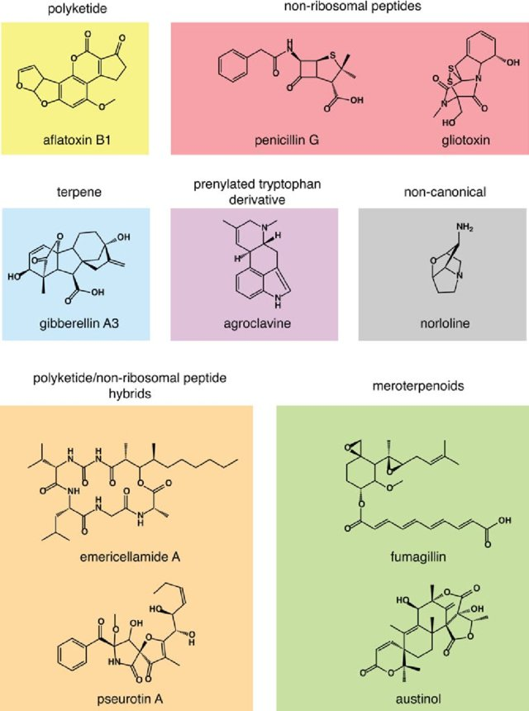
Secondary metabolites – classes:
Wieman & Keller 2013. ”Strategies for mining fungal natural products” Journal of Industrial Microbiology 41(2)
Notes:
https://www.researchgate.net/publication/258065578_Strategies_for_mining_fungal_natural_products

Slide 6
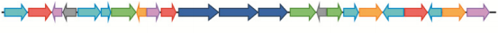
Secondary metabolites encoding genes are organized in:
Biosynthetic Gene Clusters (BGCs)
Physically clustered group of two or more genes in a particular genome that together encode a biosynthetic pathway to produce a specialized metabolite.
Encodes for:
Biosynthetic enzymes;
Resistance enzymes;
Enzymes to produce unusual building blocks;
Regulatory machinery.
A BGC represents a biosynthetic and evolutionary unit.
Cummings et al. 2014. “Steps towards the Synthetic Biology of Polyketide Biosynthesis.” FEMS Microbiology Letters 351(2): 116–25.
Notes:
A BGC can be defined as a physically clustered group of two or more genes in a particular genome that together encode a biosynthetic pathway for the production of a specialized metabolite (including its chemical variants)
bacterial natural products are generally clustered into contiguous stretches of DNA
PKS biosynthetic enzymes
resistance enzymes specific to the produced metabolite
enzymes required to produce unusual building blocks
regulatory machinery to control transcription in the native host.
6

Slide 7


Horizontal gene transfer (HGT)
Evidenced by:
Their clustering;
Frequent linkage with mobile genetic elements;
Detection on plasmids.
BGCs are prone to horizontal gene transfer (HGT)
Mutation
Recombination
Gene gain
BGC diversification mechanisms
Guided by:
selective pressures;
opportunities for genetic exchange.
Gene loss
Gene duplication
Successive merge of smaller subclusters
Jensen, Paul R. 2016. “Natural Products and the Gene Cluster Revolution.” Trends in Microbiology 24(12): 968–77
Notes:
BGCs proposed → among life's most diverse and rapidly evolving genetic elements
7

Slide 8
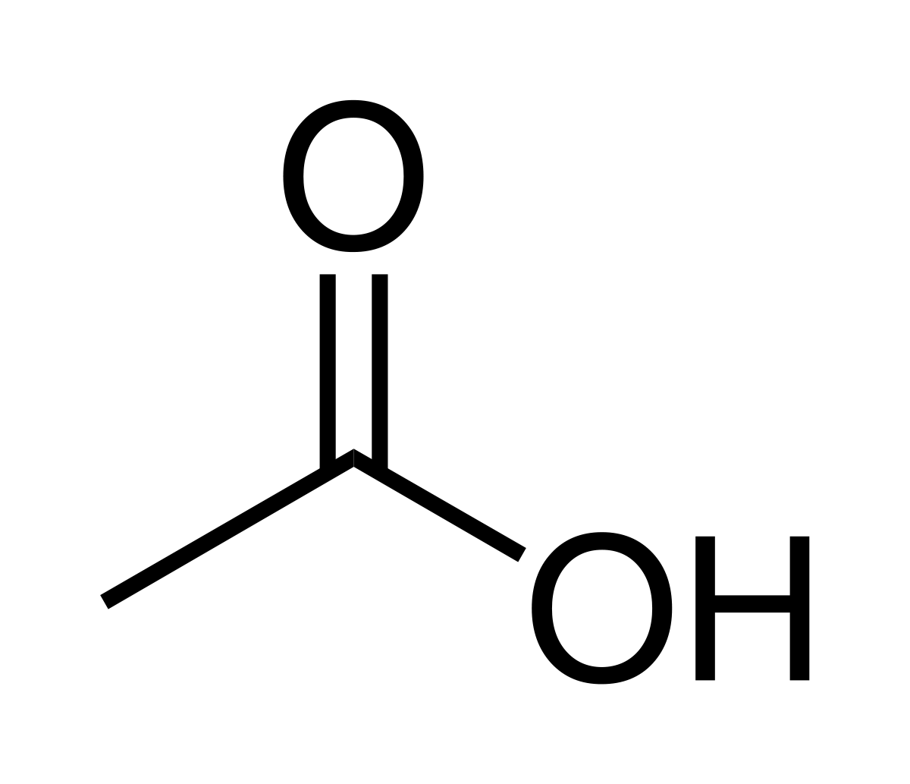

Polyketides
One of the largest classes of natural products.
Synthesized by large multifunctional enzymes: Polyketide Synthases (PKS).
Extremely high structural diversity.
Important applications in medicine and pharmaceutical industry.
The building blocks used are derived from one of the simplest molecules available in nature: acetic acid
Most common:
Malonyl-CoA
Methylmanoyl-CoA
Lovastatin A
Cholesterol-lowering drug
Notes:
These compounds improve bacterial fitness through selective and specific interactions with biological targets
Polyketides are synthesized in bacteria, fungi, plants, and certain marine animals by the stepwise condensation of acetyl-CoA or propionyl-CoA with malonyl-CoA or methylmalonyl-CoA extender units. Each condensation reaction is driven by the decarboxylation of the extender unit and yields a beta-keto functional group (e.g., an acetoacetyl group; this is why the ultimate product is called a polyketide).
8

Slide 9
Famous Polyketides
Important therapeutic drugs
Spinosyn A Insecticide
Pederin Antitumoral agent
Amphotericin B
Antifungal
Tetracycline Antibiotic
Avermectin B1 Anti-helmintic
Lovastatin A Cholesterol-lowering drug
Notes:
These compounds improve bacterial fitness through selective and specific interactions with biological targets
Polyketide antibiotics include many of the most commonly used antibiotics in medicine today such as erythromycin, rapamycin and avermectin.
Pederin is a vesicant toxic amide with two tetrahydropyran rings, found in the haemolymph of the beetle genus Paederus, including the Nairobi fly, belonging to the family Staphylinidae. It was first characterized by processing 25 million field-collected P. fuscipes.^{[1]} It makes up approximately 0.025% of an insects weight (for P. fuscipes).^{[1]}
It has been demonstrated that the production of pederin relies on the activities of an endosymbiont (Pseudomonas ssp.) within Paederus
9

Slide 10





General PKS composition
Loading module
Final module
Elongation modules
n modules
Minimal Elongation domains
Additional domains
Weissman, Kira J., and Peter F. Leadlay. 2005. “Combinatorial Biosynthesis of Reduced Polyketides.” Nature Reviews Microbiology 3(12): 925–36
Notes:
AT – selects the new unit of the polyketone chain activated by coenzyme A and transfers to ACP
KS – forms the C-C bond between the new unit and the growing chain (decarboxylative condensation)
ACP – transfers the new unit from AT to KS domain and the growing chain from KS to the optional keto-processing domains and the ks of the next module
Further processing domains (ketoreductase (KR), dehydratase (DH), and enoylreductase (ER)) are used to catalyze the step-wise reduction of the b-keto group.
The remarkable structural diversity observed among type I PKS-derived polyketides arises largely from the combinatorial use of these modules, the variable use of three reductive domains, and a few simple building blocks such as acetate
10

Slide 11
“DEBS”: the prototype of type I PKS
Precursors
Aglicone assembly
Post-PKS processing
DEBS 1
DEBS 2
DEBS 3
Loading molecule
Module 1
Module 2
Module 3
Module 4
Module 5
Module 6
End
KR
KR
DH
ER
KR
KR
KR
Macrociclization and release
Propionyl-CoA (Starter unit)
AT
ACP
KS
AT
ACP
KS
AT
ACP
KS
AT
ACP
KS
AT
ACP
KS
AT
ACP
KS
AT
ACP
TE
+
6
6-deoxyerythronolide B
Tailoring
(2S)-Methylmalonyl-CoA (Extender unit)
AT
Acyltransferase domain
KS
Ketosynthase domain
DH
Dehydratase domain
TE
Thioesterase domain
ACP
Acyl carrier protein
KR
Ketoreductase domain
ER
Enoylreductase domain
Erythromycin A
Notes:
from Saccharopolyspora erythraea - 6-deoxyerythronolide B (6-dEB) synthase
three megasynthases encoded by three ORFs, DEBS1–3
All the modules encoded within DEBS1–3 are required for successful synthesis of 6-dEB and act in succession, like a giant molecular assembly line.
the product of one module in a polyketide synthesis pathway is passed on to the correct, subsequent module in the pathwa
How is it that reactive intermediates are directed vectorially along the assembly line?
vectorial specificity is due to the protein-protein interactions of the faces of the different protein modules in the pathways.
Polyketides are synthesized by multienzyme polypeptides that resemble eukaryotic fatty acid synthase but are often much larger.
11

Slide 12

PKSs classification
Based on
enzyme architecture:
Type I
Type II
Type III
Based on
domain organization:
Iterative
Modular (only type I)
PKSs
There are also diverse PKS-NRPS hybrids worth to mention.

Slide 13

Engineering Polyketides
Polyketides are promising targets for synthetic biology:
Highly modular architecture;
Clinical relevance;
High abundance.
Pathways can be manipulated/redesigned to produce new molecules.
Engineering
Strategies
can be at
Protein level
Cellular level
Barajas, Jesus F. et al. 2017. “Engineered Polyketides: Synergy between Protein and Host Level Engineering.” Synthetic and Systems Biotechnology 2(3): 147–66.
Notes:
In addition to the clinical relevance and abundance of polyketides, there is one other reason behind the particular interest in polyketides as promising targets for synthetic biology: the highly modular architecture of both the BGCs and the constituent polyketide synthases (PKS) presents an ideal starting point from which to engineer chemical novelty in polyketides.
13

Slide 14
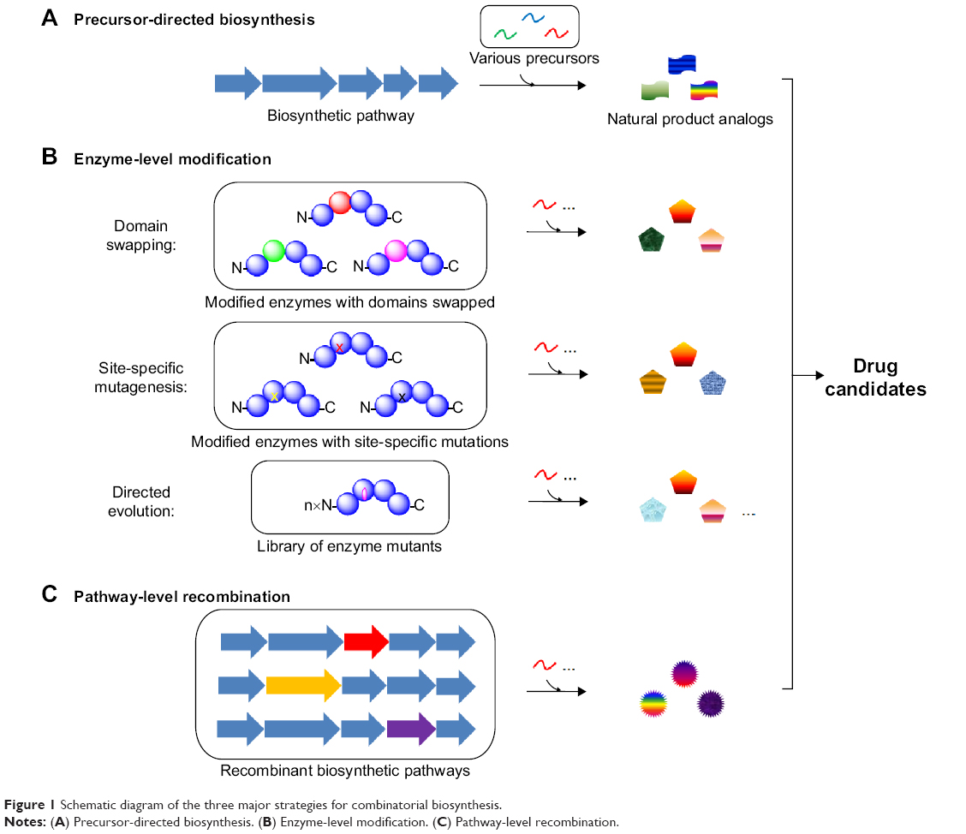

PKS protein modifications
Engineering
Strategies
Protein level
Reductive loop swaps
AT, KR
mutagenesis
Domain fusion
Possible strategies
Entire modules or
single domains (TE, AT).
Different substrate specificity or higher substrate promiscuity.
Modification of active sites
Domain swapping
Change of pool of building blocks.
Barajas, Jesus F. et al. 2017. “Engineered Polyketides: Synergy between Protein and Host Level Engineering.” Synthetic and Systems Biotechnology 2(3): 147–66.
Sun, Huihua, Zihe Liu, Huimin Zhao, and Ee Lui Ang. 2015. “Recent Advances in Combinatorial Biosynthesis for Drug Discovery.” Drug Design, Development and Therapy 9: 823–33.
Notes:
Combinatorial biosynthesis
14

Slide 15
Polyketide diversification
Pool of starter units
Pool of extender units
β-keto processing
Stereochemistry
Alkylation/branching
Oxygenation
Halogenation
Alkylation
Glycosylation
Primary
core
structure
Secondary core
structure
Final
polyketide metabolite
PKS
Polyketide backbone
Domain composition
1st tailoring
2nd tailoring
Choice of building blocks
Chain length
Rearrangements
2nd cyclization
Combinatorial biosynthesis
Erythromycin A
Hertweck, Christian. 2009. “The Biosynthetic Logic of Polyketide Diversity.” Angewandte Chemie - International Edition 48(26): 4688–4716.
Notes:
15

Slide 16

Heterologous expression of BGCs
Engineering
Strategies
Cellular level
Strategy to produce compounds
Too complex to be chemically synthesized.
Produced by complex, slow-growing microorganisms.
Allow the expression of cryptic (silent) BGCs.
Overproduction of target compounds.
Possible hosts:
Streptomyces
Myxobacteria
Escherichia coli
Saccharomyces cerevisiae
Heterologous production of polyketides was first demonstrated with Streptomyces parvulus in 1984.
Notes:
S.parvulus: actinorhodin - antibiotic activity
The selection of a heterologous host is contingent upon its ability to efficiently transcribe non-native pathways, translate the
often GC rich transcripts, and possess all the starter and extender units necessary for polyketide production
E. coli seems to be well suited for expression of pathways originating from Cyanobacteria that are challenging to modify genetically.
The titres of SMs produced in E. coli have been generally low.
Furthermore, synthetic biology allows the redesign of BGCs for effective heterologous expression in pre-engineered hosts, which will ultimately empower the construction of standardized high-throughput platforms for natural product discovery
16

Slide 17
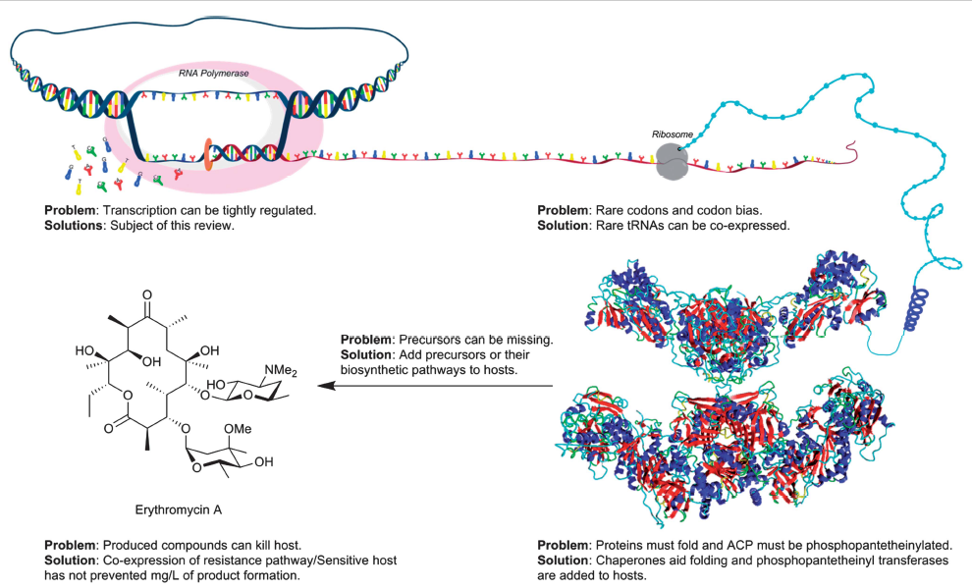
Challenges in Heterologous BGC expression
Promoter replacement
Transcription from native promoters
Stevens, D. Cole, Taylor P A Hari, and Christopher N. Boddy. 2013. “The Role of Transcription in Heterologous Expression of Polyketides in Bacterial Hosts.” Natural Product Reports 30(11): 1391–1411.
Notes:
Since E. coli and S. cerevisiae are not naturally equipped for production of complex chemicals, issues with metabolic flux, codon usage, self-resistance and activation of biosynthetic acyl/peptidyl carrier proteins need to be resolved
To guarantee successful translation:
Directed promoter replacement
Use a host that is closely related to the native strain and rely on the native promoters from the gene cluster to be functional
17

Slide 18
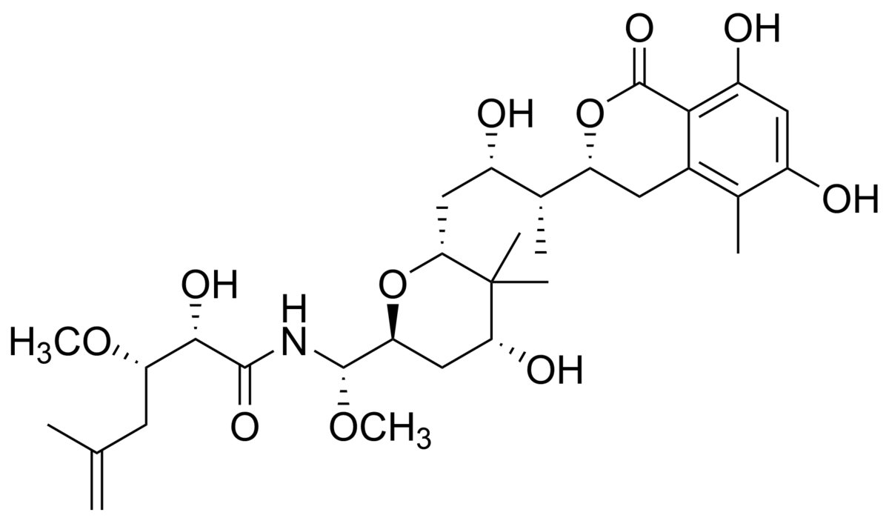
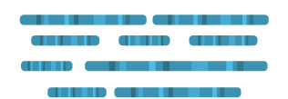
Discovery methods of new BGCs
Psymberin
Discovered from sponge’s metagenomic DNA.
Metagenomics
Powerful tool for the discovery of novel PKSs, particularly from uncultivable bacteria.
Production of Metagenomic Library
Screening for polyketides BGCs
Heterologous
expression
Metagenomic DNA
Fisch, Katja M. et al. 2009. “Polyketide Assembly Lines of Uncultivated Sponge Symbionts from Structure-Based Gene Targeting.” Nature Chemical Biology 5(7): 494–501
Notes:
Psymberin: citotoxin from sea sponge
Very similar structure to pederin, a natural product derived from the Paederus genus of beetles
trans-AT polyketide synthase cluster, designated as the Psy cluster
18

Slide 19




Discovery methods of new BGCs
The Genomics Era
Has led to a shift in Natural Products Research.
In silico discovery of novel BGCs.
Genome Mining
Through several different informatic algorithms and databases.
Notes:
The traditional discovery of new natural products that was mainly driven by bioactivity screening has now experienced a fresh new approach in the form of genome mining.
thee vast improvement in DNA sequencing in the past decade has led to the identification of many gene clusters encoding polyketide assembly lines.
19

Slide 20
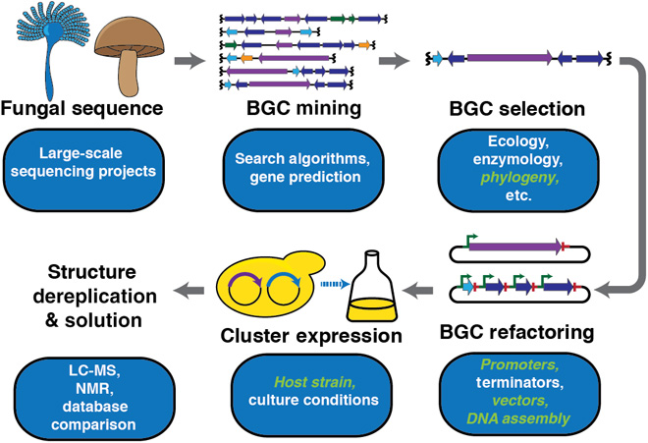
Discovery methods of new BGCs
B Harvey CJ, Tang M, Schlecht U, Horecka J, Fischer CR, Lin H-C, et al. 2018 “HEx: A heterologous expression platform for the discovery of fungal natural products.” Sci Adv.(4)
Notes:
Filamentous fungi are prolific producers of polyketides
20

Slide 21
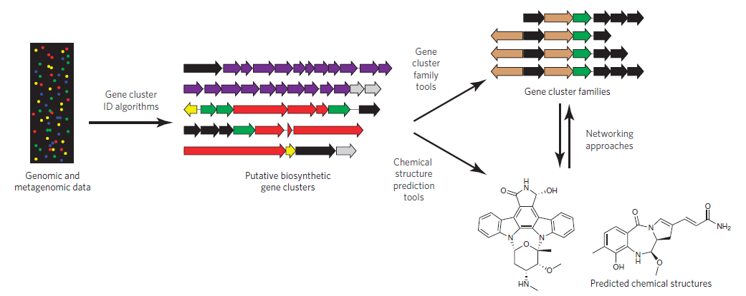
Computational Approaches in Natural Products Discovery
Scale-up
Medema, Marnix H., and Michael A. Fischbach. 2015. “Computational Approaches to Natural Product Discovery.” Nature Chemical Biology 11(9): 639–48.
Notes:
The approach I used to study the secondary metabolism → Genome Mining
21

Slide 22
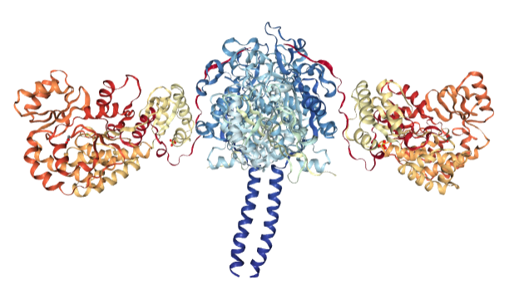
The ultimate goal: an integrative approach
Genome
Mining
Structural
biology
KS-AT didomain of module 5 from DEBS
Integrative approach
Metabolomics
Molecular genetics
Metagenomics
Computational
Biology
Synthetic
biology
Medema, Marnix H. 2018. “Computational Genomics of Specialized Metabolism: From Natural Product Discovery to Microbiome Ecology.” mSystems 3(2): e00182-17.
Notes:
22

Slide 23
Case-study:
Secondary metabolite biosynthesis by Aquimarina species:
emerging bioactivities from the rare marine biosphere

Slide 24
The marine environment
Percentage of new marine drugs (2006 - 2016):
Sources:
Is a prolific source of novel bioactive natural products
Raimundo, I, Silva, SG., Costa, R & Keller-Costa, T 2018 Marine Drugs
Notes:
Marine Bacteria
~200 novel compounds/year
Marine Fungi ~
500 novel compounds/year
Microorganisms have been na excelent source of new drugs
And in recente years, we have came to the conslusion that marne biomes are incredible reservoirs of new compounds
One of the most promising ecossystems to look for new bioactive compound is the oceans.
As you can see, in 2006: less than 20% of the total new marine drugs were from microorganisms.
This percentage raised to 50% in 2016
24

Slide 25
Novel Natural Products from the Seas
Source of microorganisms
Microorganisms from Invertebrates
Sponges and soft corals stand out as hosts for microorganisms with potential for the biosynthesis of new compounds.
Year: 2013
Raimundo, I, Silva, SG., Costa, R & Keller-Costa, T 2018 Marine Drugs
Notes:
Many of the microrrganisms that are found to produce interesting compound come from sponges and soft corals
25

Slide 26
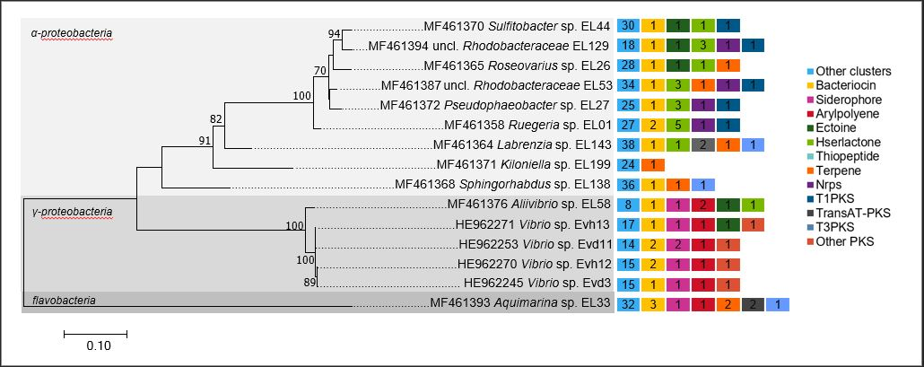
Potential for Secondary Metabolite Synthesis in Soft Coral-Associated Bacteria
Bacterial isolates
Number of BGCs per Genome
Reported activities for these type of compounds:
Antibacterial
Antifungal
Antiviral
Antifouling
Anticancer
Antimalarial
Antiinflammatory
440 biosynthetic gene clusters (BGCs) on the genomes of 15 bacterial associates (12 genera) isolated from the soft corals Eunicella labiata and Eunicella verrucosa.
Raimundo, I, Silva, SG., Costa, R & Keller-Costa, T 2018 Marine Drugs
Notes:
To have an idea of this potential, we recently performed
a comparative genomcs approach of the genomes of 15 bacterial isolates from the gorgonian coral Eunicella labiata
Where you can see a huge biosynthetic potential.
We were specially intrigued by a particular genus, the Aquimarina genus
Polyketides: structurally complex & diverse secondary metabolites (examples: Erythromycin, Tetracyclines, Avermectin)
26

Slide 27
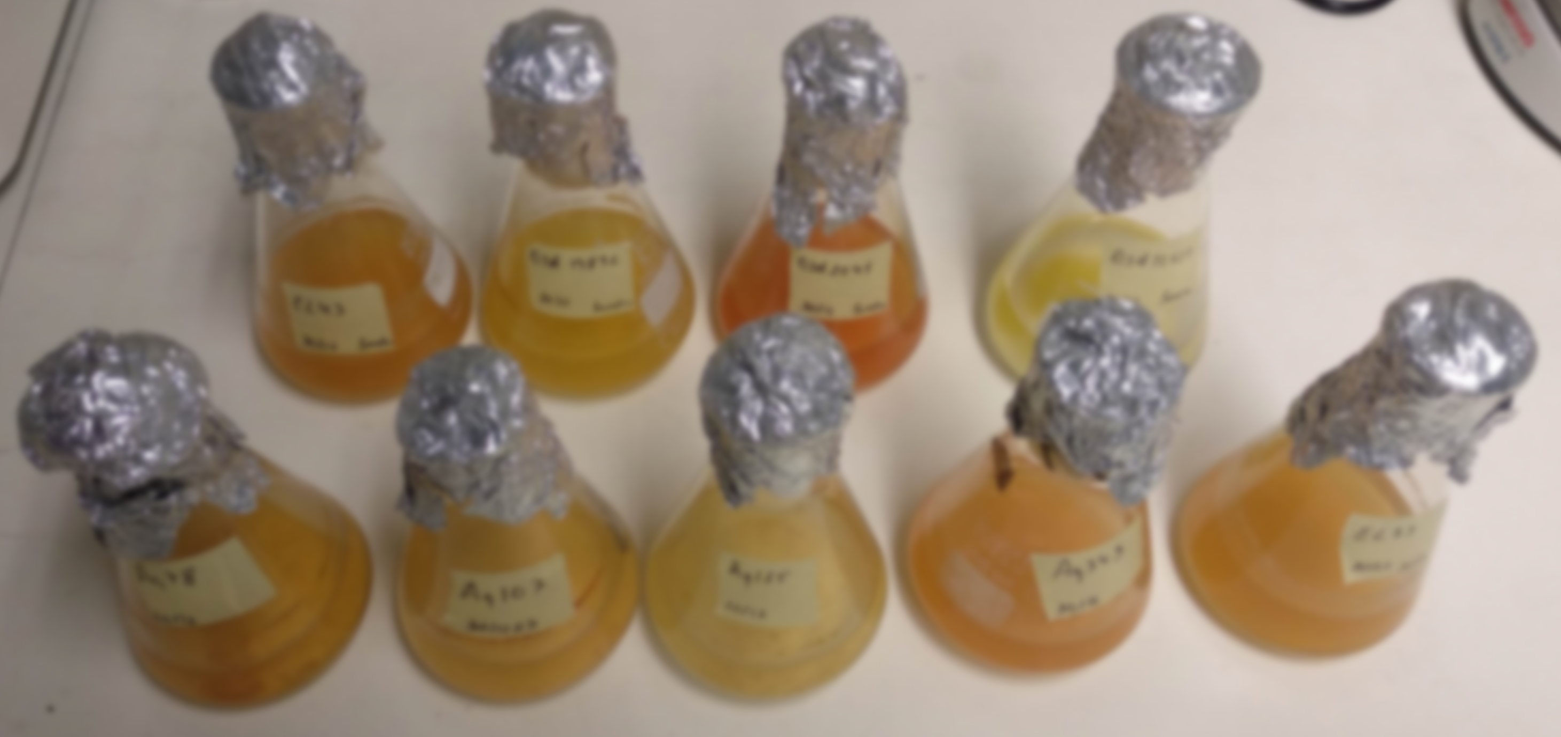
The Aquimarina genus
Phylum: Bacteroidetes
Family: Flavobacteriaceae
Genus: Aquimarina
Gram-negative bacteria;
Strictly marine;
Heterotrophic;
Versatile carbon metabolism;
Yellow or orange-pigmented.
Notes:
From the Bacteroidetes phylum, These are marine bacteria with an important role in mediating carbon and nitrogen cycling.
Recent studies have shown pathogenic beahaviour, for exemple in algae and lobster shells.
This, coupled with the genomic information we had untilthat moment, lead us to explore deeply this genus, making it the core of my PhD work
27

Slide 28
The Aquimarina genus
Unknown biotechnological potential?
Involved in the regulation of harmful microbial blooms through mediation of carbon and nitrogen cycling.
Emerging evidence of pathogenic behavior in some marine invertebrates.
Distinct secondary metabolism already observed for some isolates.
Notes:
From the Bacteroidetes phylum, These are marine bacteria with an important role in mediating carbon and nitrogen cycling.
Recent studies have shown pathogenic beahaviour, for exemple in algae and lobster shells.
This, coupled with the genomic information we had untilthat moment, lead us to explore deeply this genus, making it the core of my PhD work
28

Slide 29
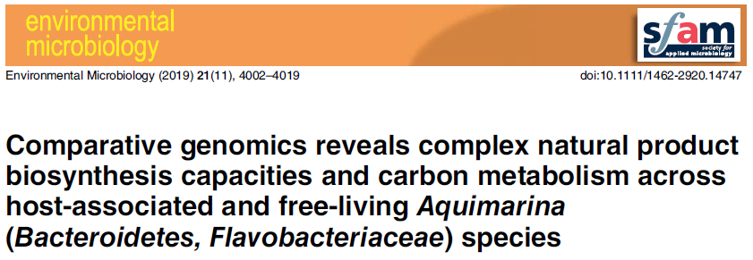
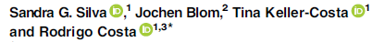
Notes:
The Aquimarina genus possesses a vast potential to synthesize a large variety of secondary metabolites
29

Slide 30
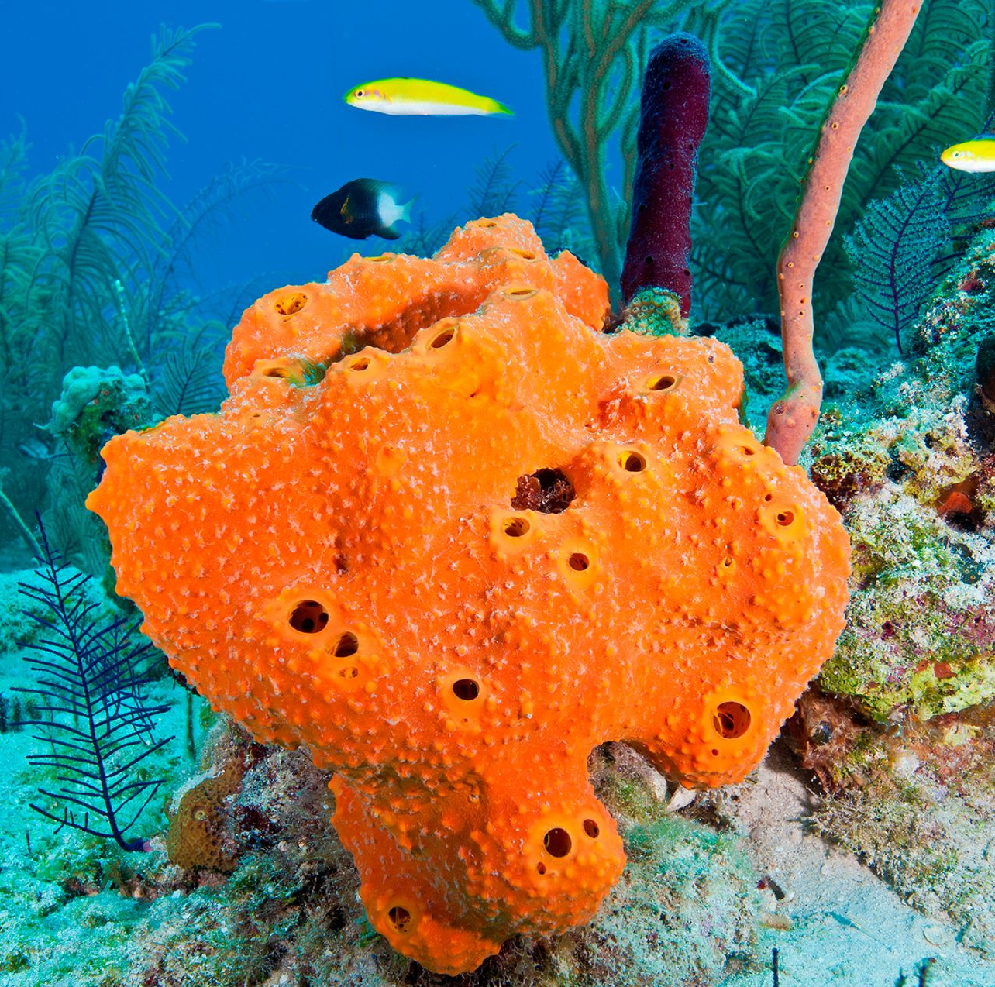
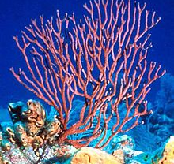
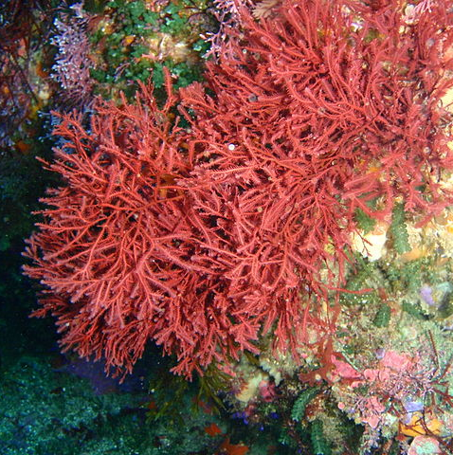
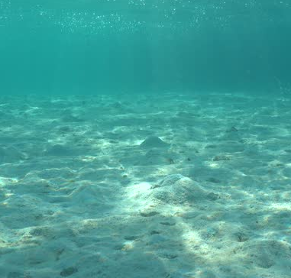

Comparison of 26 Aquimarina genomes from several isolation sources
Host-associated (HA)
Free-living (FL)
Marine sponges
Gorgonian coral
Red algae
Marine sediments
Seawater
Silva, SG., Blom, J., Keller-Costa, T, Costa, R. 2019 Environmental Microbiology
Notes:
The Aquimarina genus possesses a vast potential to synthesize a large variety of secondary metabolites
30

Slide 31




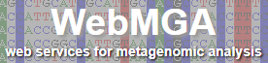
Methods
Analysis of all available Aquimarina genomes at NCBI (25/02/2019)
Download of 26 genomes
Genome annotation on
16S rRNA
phylonetic analysis
Annotation on COGs and Pfams
BGCs identification
Phylogenomics analysis
Notes:
31

Slide 32


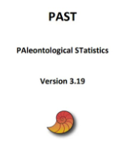

16S rRNA
phylogenetic analysis
Annotation on COGs and Pfams
BGCs identification
Phylogenomic analysis
Construction of a phylogenetic tree
Identification of inter-strain BGCs
Construction of a phylogenenomic tree
Data treatment
Statistical analysis
Notes:
32

Slide 33

Goals
Search for biosynthetic gene clusters (BGCs).
Comparison between
host-associated and
free-living organisms.
Study of
26 Aquimarina
genomes
Are Aquimarina species potential sources of novel bioactive natural products?
Describe general features of the genus.
Notes:
Goals
Search for biosynthetic gene clusters (BGCs) → Are Aquimarina species potential sources of novel bioactive natural products?
General description of the genus → What are the core metabolic traits of the Aquimarina genus?​
Comparison between Host-associated and Free-living organisms → Presence of a functional difference ?
33

Slide 34
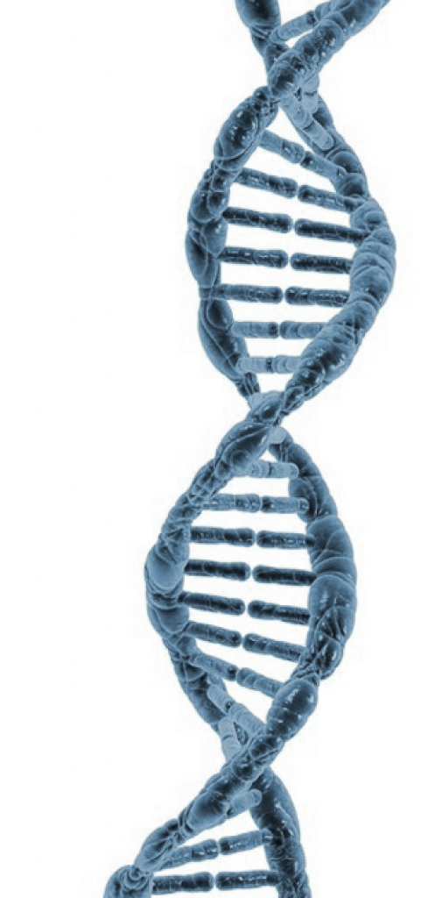
Genomes Overview
26 genomes.
Genome size range: from 4.07Mb (Aq. atlantica) to 6.5 Mb (Aq. AU119).
Average: 5,6 Mb.
GC content range: from 31.4 (Aq. muelleri) to 35.9 (Aq. spongiae).
Average: 32.72%.
Average number of coding sequences per genome: 5480 CDSs.
Core genome: 1226 CDSs.
Pan genome: 21211 CDSs.
Notes:
34

Slide 35
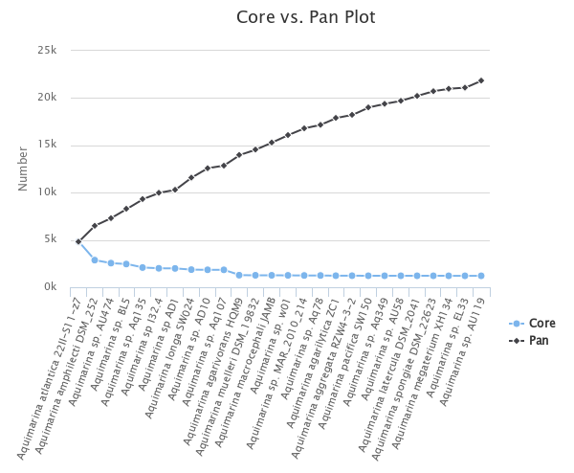

Whole-genome sequence alignment
CDSs
These data suggests:
open pangenome.
Common in species living in a community.
Tendency to large genomes and high horizontal rate of genes transfer.
Silva, SG., Blom, J., Keller-Costa, T, Costa, R. 2019 Environmental Microbiology
Notes:
35

Slide 36

Functional Annotation
COG
Clusters of Orthologous Groups
Protein families’ database
2320 | Number of different ORFs |  | 4187
1024 | Core (Nr. ORFs present in all strains) |  | 1130
248 | Unique (Nr. of ORFs only present in one strain) |  | 1716
87646 | Total number of ORFs |  | 242234
3371 | Average of number of ORFs per strain |  | 9317
44%
27%
Notes:
Copy number of open reading frames (ORFs) of biocatalyst protein families (PFAM) present in all Aquimarina genomes
36

Slide 37
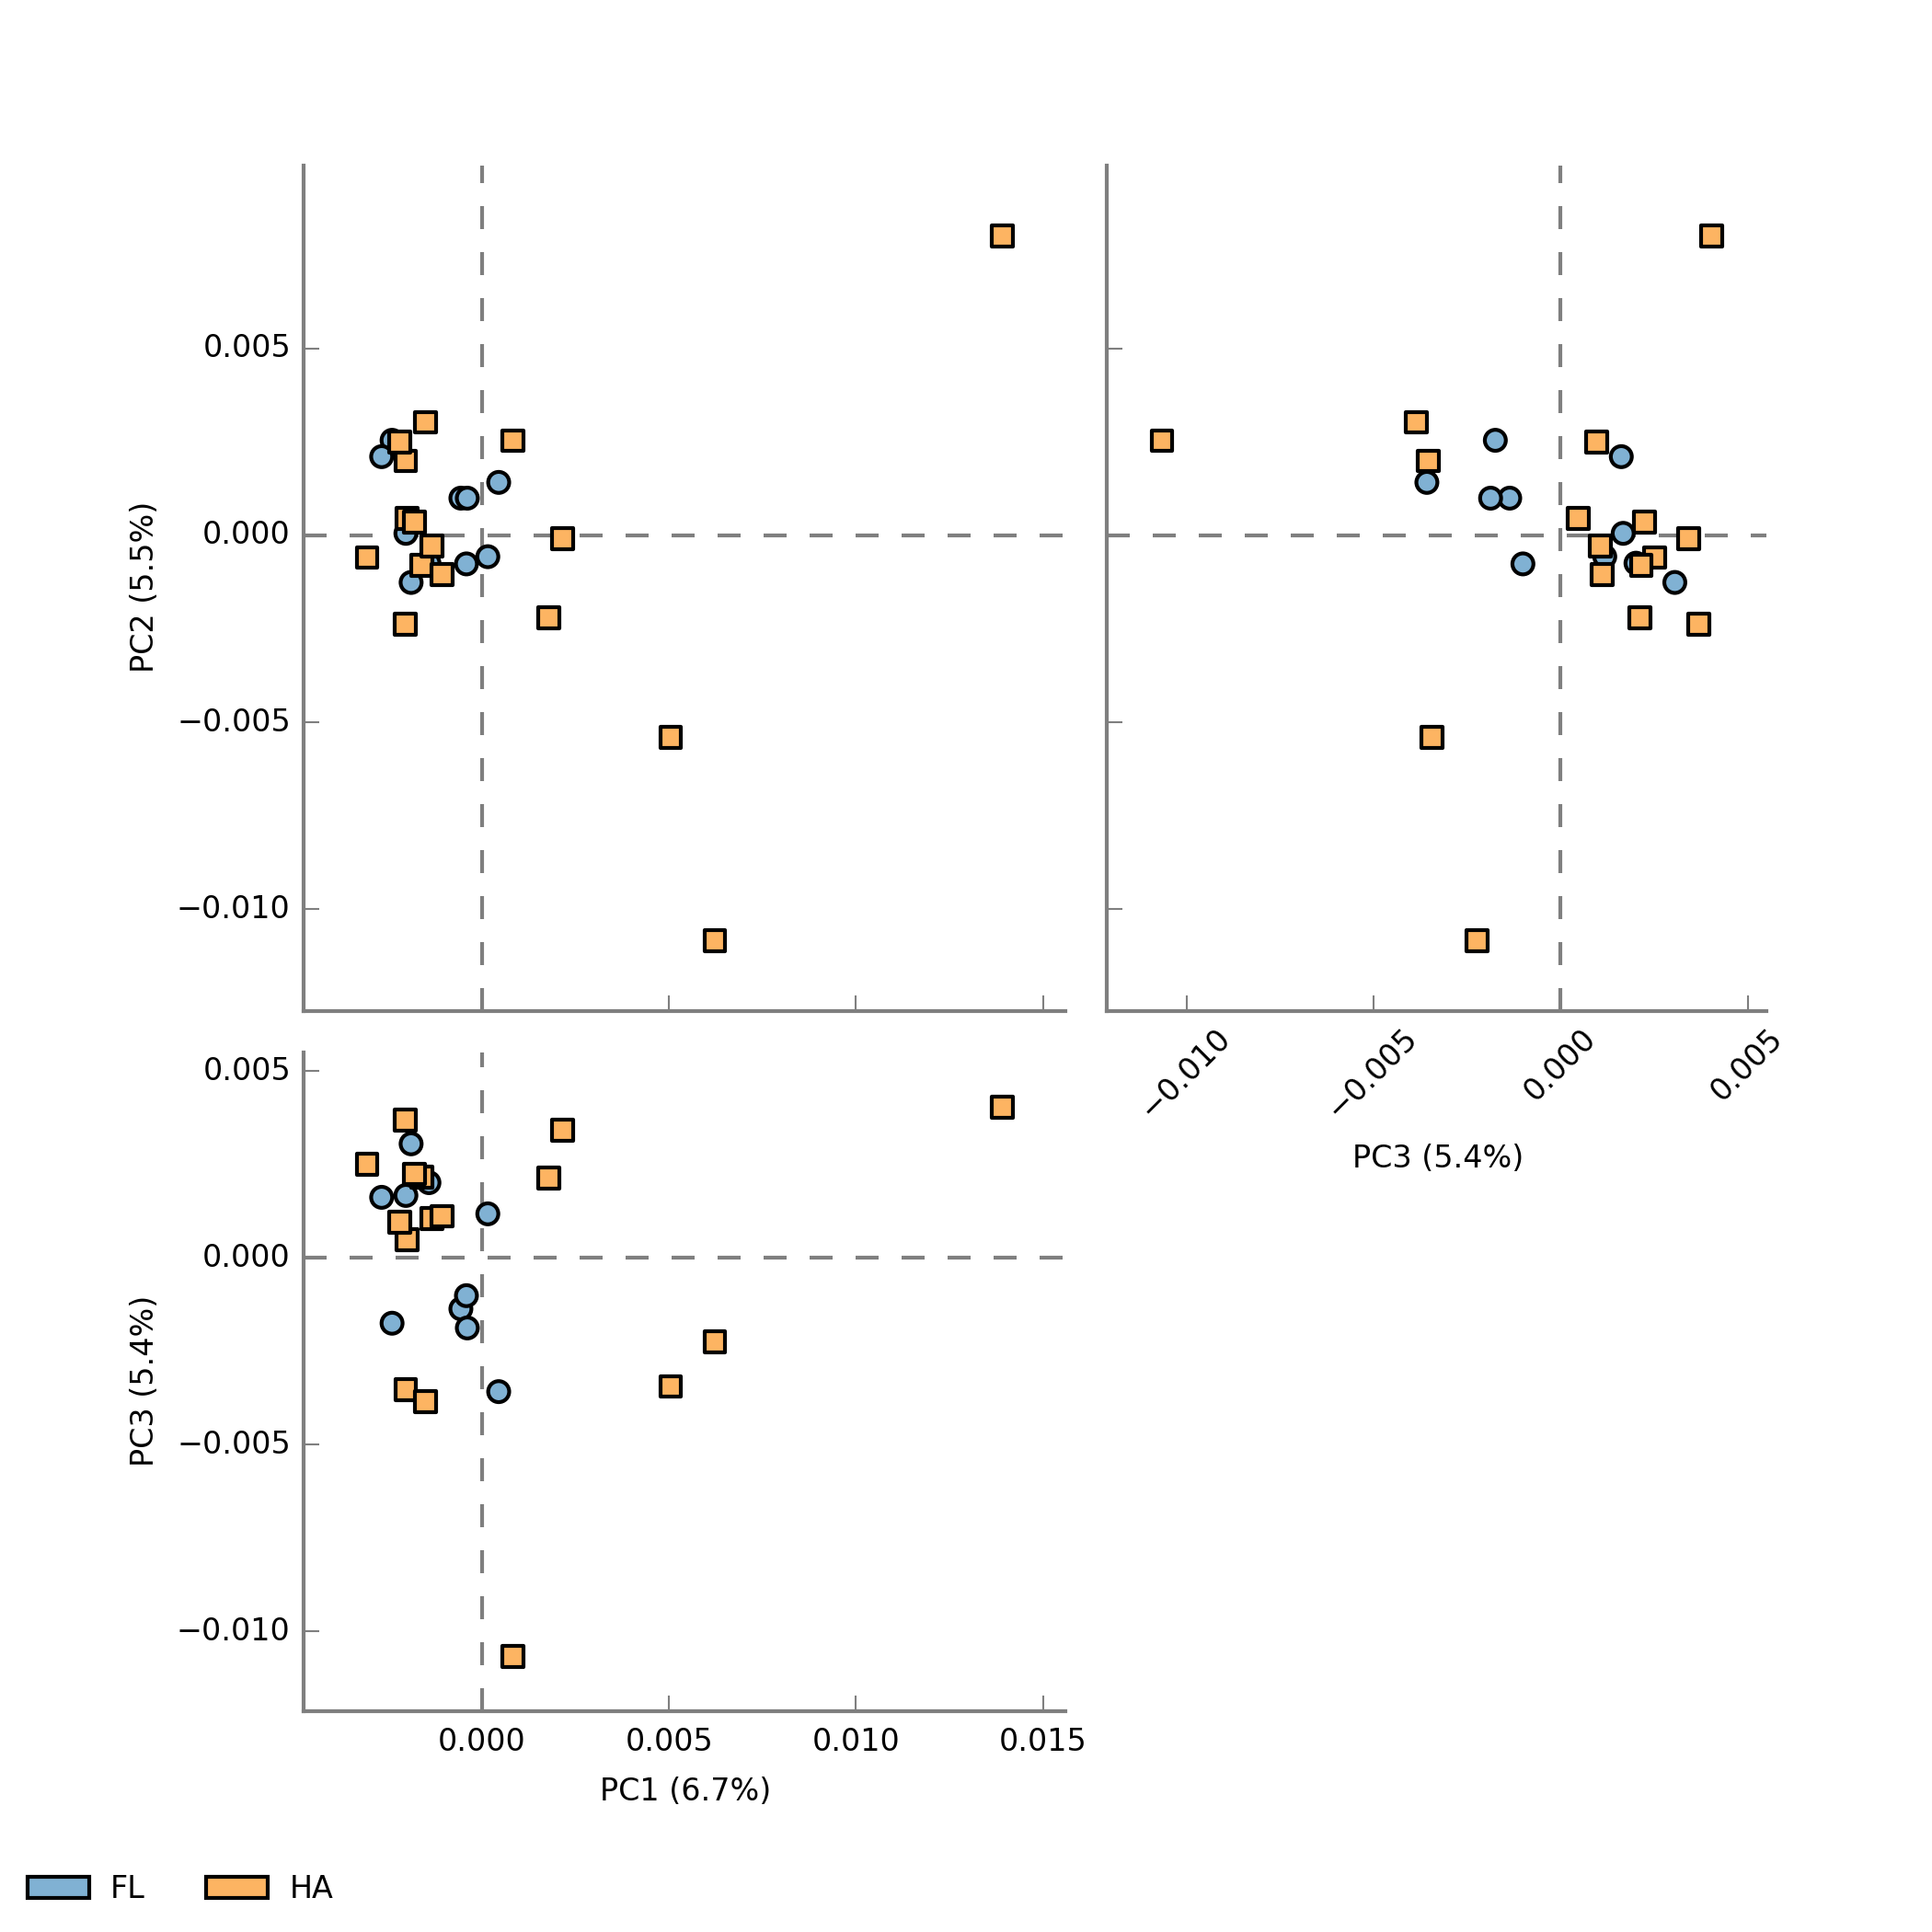
Principal Component Analysis (PCA)
Aquimarina sp. 349
One single group:
Aquimarina sp. I32.4
Aquimarina longa
Aquimarina muelleri
Aquimarina sp. Aq135
Aquimarina sp. w01
Aquimarina sp. MAR
Aquimarina atlantica
Aquimarina macrocephali
Aquimarina sp. AU58
Aquimarina sp. EL33
Aquimarina megaterium
Aquimarina sp. AU474
Aquimarina spongiae
Aquimarina sp. Aq107
Aquimarina aggregata
Aquimarina latercula
Aquimarina sp. BL5
Aquimarina sp. AD10
Aquimarina pacifica
Aquimarina agarivorans
Aquimarina agarilytica
Aquimarina amphilecti
Aquimarina sp. 349
Aquimarina sp. AU119
annotation
Absence of a statistical difference between annotated genomes
Aquimarina sp. Aq78
Aquimarina sp. Aq78
Aquimarina sp. AD10
Aquimarina sp. AD10
Aquimarina sp. 349
Aquimarina sp. AD10
Aquimarina sp. Aq78
Outside of the group:
Aquimarina sp. 349
Aquimarina sp. 78
Aquimarina sp. AD10
Aquimarina sp. AU119
Aquimarina sp. AU119
Notes:
Absence of clustering by life-style
37

Slide 38
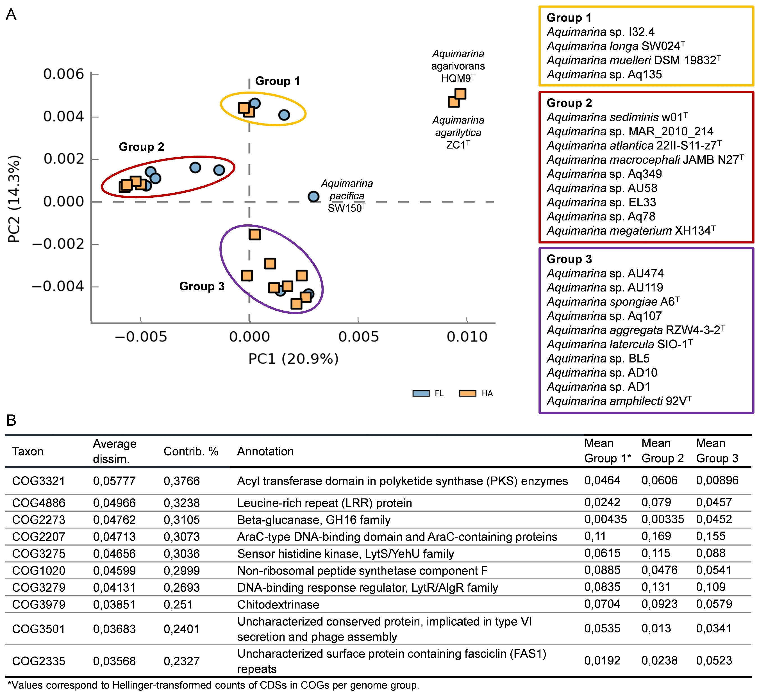
COG
Principal Component Analysis (PCA)
annotation
Silva, SG., Blom, J., Keller-Costa, T, Costa, R. 2019 Environmental Microbiology
Notes:
The Aquimarina genus possesses a vast potential to synthesize a large variety of secondary metabolites
38

Slide 39
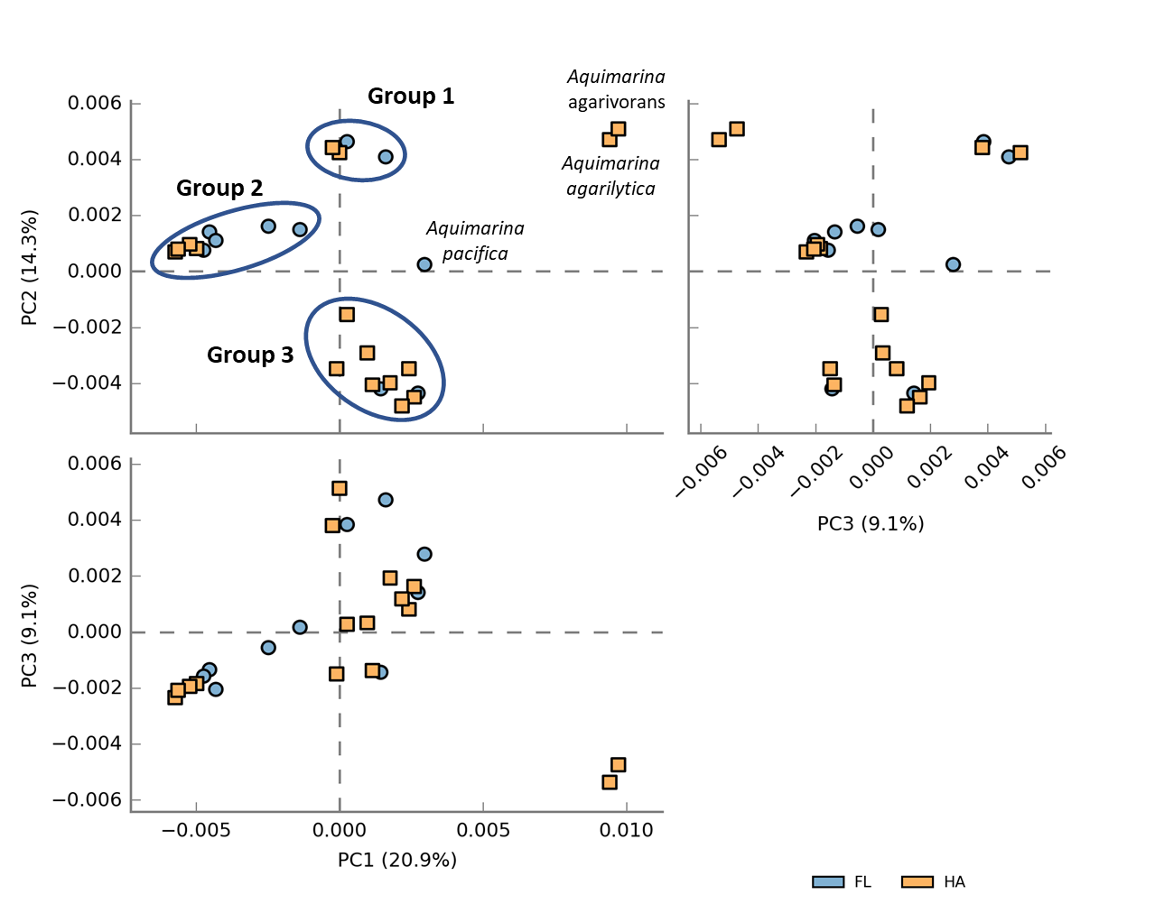
COG
annotation
Are these groups statistically significant?
Yes
Confirmed by one-way Permanova
(Permutational analysis of variance)
Division of the 26 genomes into 3 clusters
Which COGs are more contributive for the formation of these 3 groups?
SIMPER analysis
Notes:
COGs
STAMP
Default settings
39

Slide 40
COG
SIMPER analysis
annotation
COGs related with secondary metabolism
Taxon | Av. dissim | Contrib. % | Annotation
COG3321 | 0,05777 | 0,3766 | Acyl transferase domain in polyketide synthase (PKS) enzymes
COG4886 | 0,04966 | 0,3238 | Leucine-rich repeat (LRR) protein
COG2273 | 0,04762 | 0,3105 | Beta-glucanase, GH16 family
COG2207 | 0,04713 | 0,3073 | AraC-type DNA-binding domain and AraC-containing proteins
COG3275 | 0,04656 | 0,3036 | Sensor histidine kinase, LytS/YehU family
COG1020 | 0,04599 | 0,2999 | Non-ribosomal peptide synthetase component F
COG3279 | 0,04131 | 0,2693 | DNA-binding response regulator, LytR/AlgR family
COG3979 | 0,03851 | 0,251 | Chitodextrinase
COG3501 | 0,03683 | 0,2401 | Uncharacterized conserved protein, implicated in type VI secretion and phage assembly
COG2335 | 0,03568 | 0,2327 | Uncharacterized surface protein containing fasciclin (FAS1) repeats
Notes:
SIMPER analysis – COGs – Groups 1, 2 and 3
LRR → eukaryotic- like proteins (ELP), possibly involved in patterns of host– symbiont recognition
LytS/YehU family → Signal transduction mechanisms
40

Slide 41
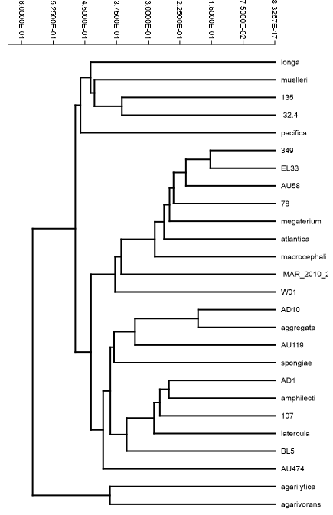
COG
annotation
Aquimarina longa
Aquimarina muelleri
Aquimarina Aq135
Aquimarina I32.4
Aquimarina pacifica
Group 1
Aquimarina sp. Aq349
Aquimarina sp. EL33
Aquimarina sp. AU58
Aquimarina sp. Aq78
Aquimarina megaterium
Aquimarina atlantica
Aquimarina macrocephali
Aquimarina sp. MAR
Aquimarina sp. w01
Group 2
Aquimarina sp. AD10
Aquimarina aggregata
Aquimarina sp. AU119
Aquimarina spongiae
Aquimarina sp. AD1
Aquimarina amphilecti
Aquimarina sp. Aq107
Aquimarina latercula
Aquimarina sp. BL5
Aquimarina sp. AU474
Group 3
Clustering with the paired group (UPGMA).
5000 bootstraps.
Euclidean similarity index
Notes:
Clustering with the paired group (UPGMA) algorithm with 5000 bootstraps. – Euclidean similarity index
Coeficiente de correlação: 0,9693
41

Slide 42
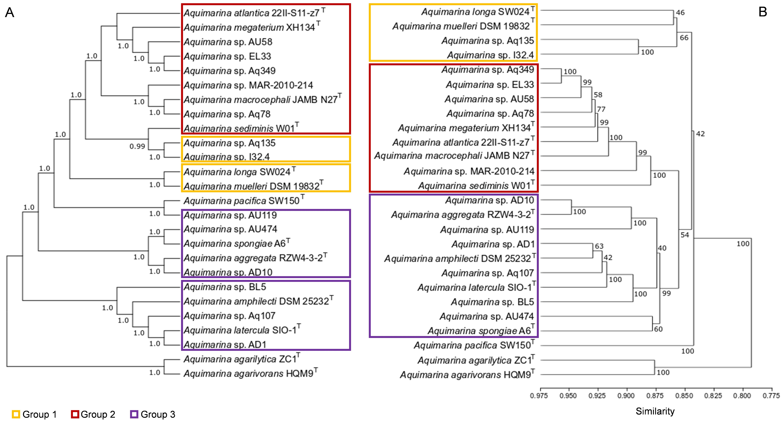
Phylogeny primarily shapes the metabolism of Aquimarina species
Phylogenomic tree based on ANI
Dendogram based on COG annotation
Silva, SG., Blom, J., Keller-Costa, T, Costa, R. 2019 Environmental Microbiology
Notes:
The Aquimarina genus possesses a vast potential to synthesize a large variety of secondary metabolites
42

Slide 43
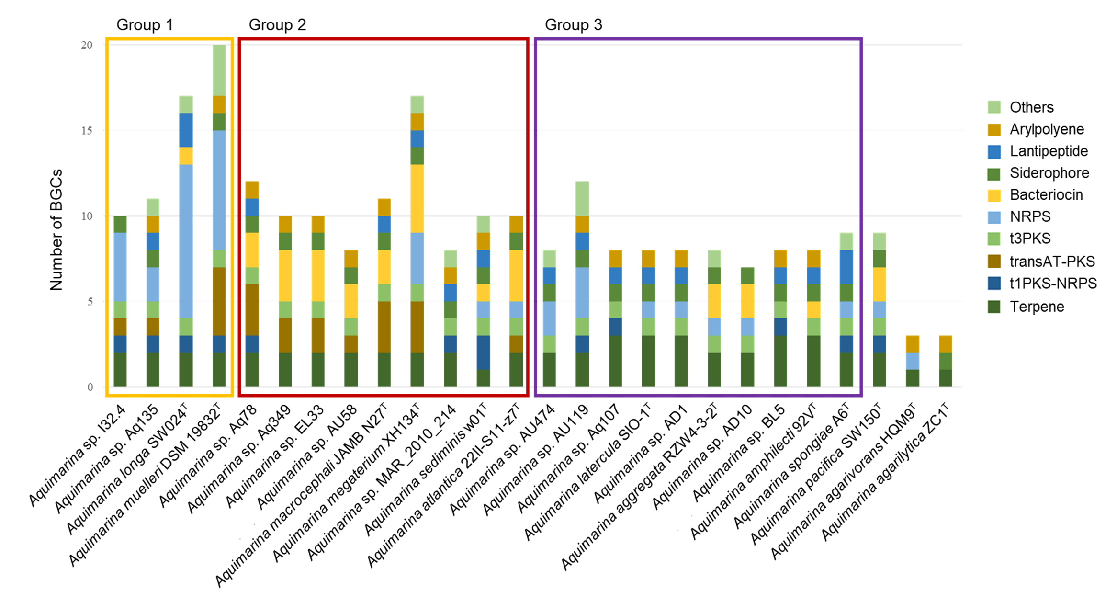
Identification of BGCs
Total count: 928 BGCs
54 terpenes
13 t1PKS-NRPS
21 transATPKS
24 t3pPKS
39 NRPS
High biosynthetic diversity
Silva, SG., Blom, J., Keller-Costa, T, Costa, R. 2019 Environmental Microbiology
Notes:
High number of NRPSs
And polyketide synthases
43

Slide 44
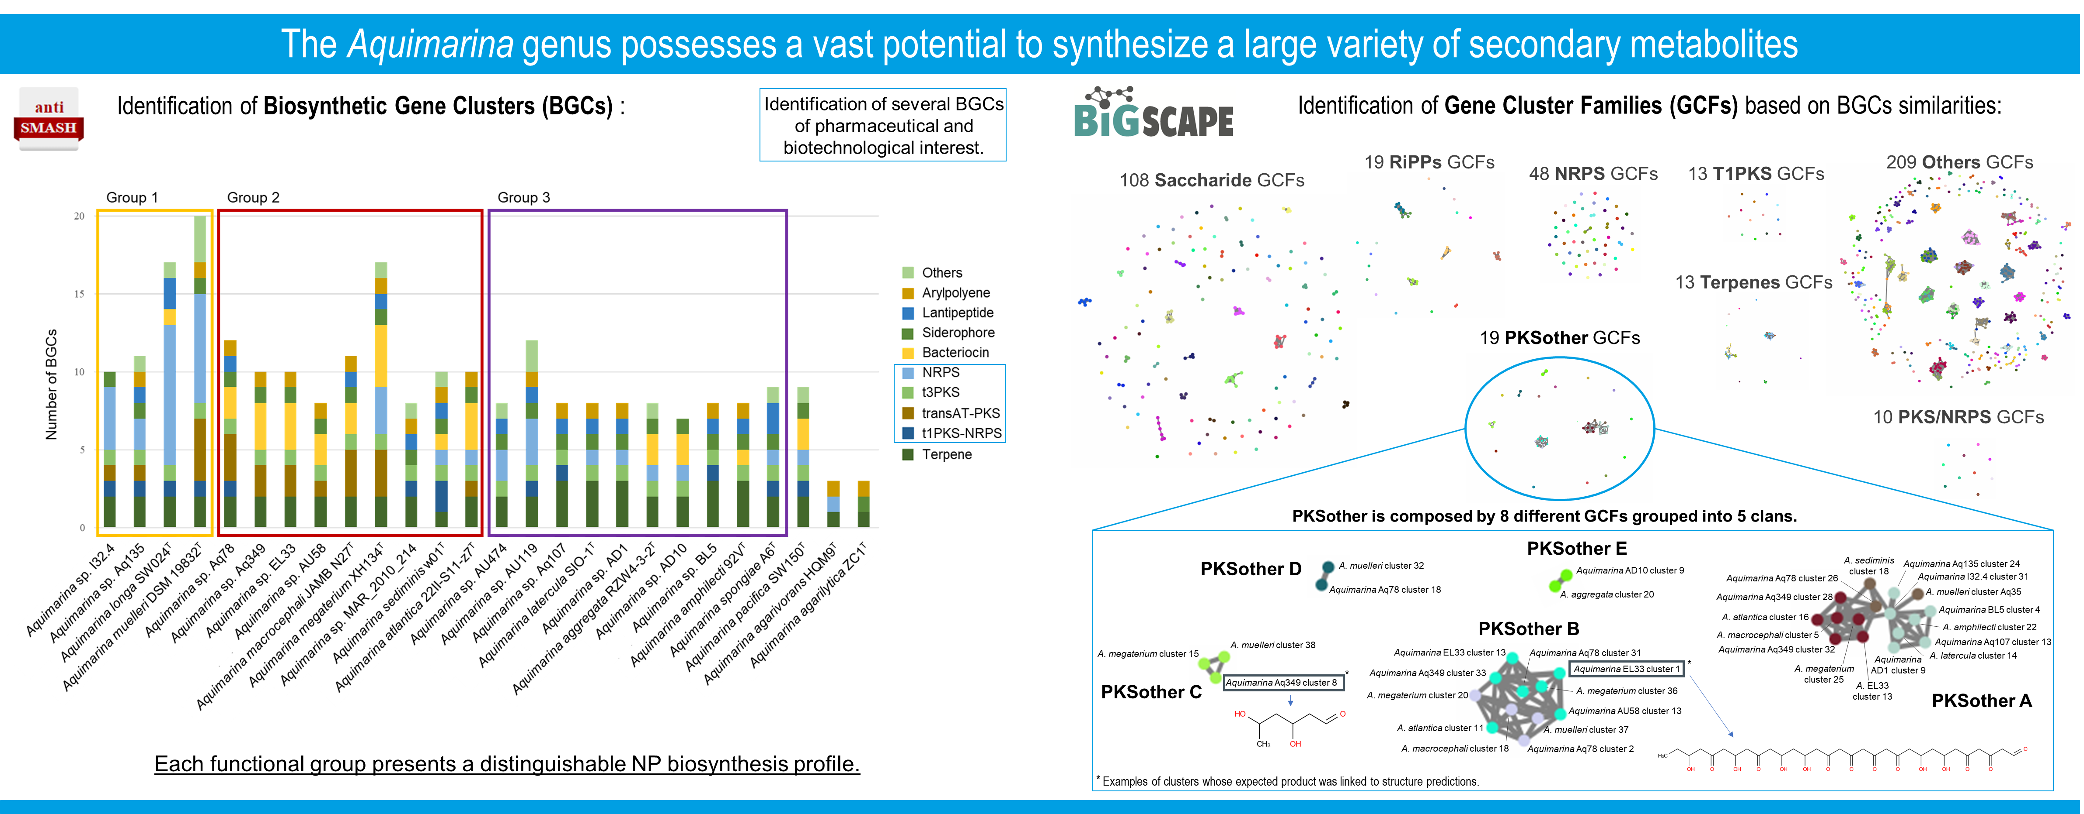
439
Gene Cluster Families
Notes:
The Aquimarina genus possesses a vast potential to synthesize a large variety of secondary metabolites
44

Slide 45
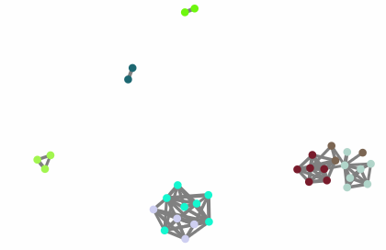

PKS-other class
Aq AD10 cluster 9
Aq aggregata cluster 20
Aq muelleri cluster 32
Genomes belong to COG cluster nº 2
Aq W01 cluster 18
Aq 135 cluster 24
Aq 78 cluster 26
Aq I324 cluster 31
Aq megaterium cluster 15
Aq muelleri cluster 38
Aq 349 cluster 28
Aq muelleri cluster 35
Aq atlantica cluster 16
Aq BL5 cluster 4
Aq 349 cluster 8
Aq macrocephali cluster 5
Aq amphilecti cluster 22
Aq EL33 cluster 13
Aq 78 cluster 31
Aq EL33 cluster 1
Aq 349 cluster 32
Aq 107 cluster 13
Aq 349 cluster 33
Aq AD1 cluster 9
Aq latercula cluster 14
Aq megaterium cluster 36
Aq megaterium cluster 25
Aq megaterium cluster 20
Aq EL33 cluster 13
Aq AU58 cluster 13
Aq atlantica cluster 11
Aq muelleri cluster 37
Aq macrocephali cluster 18
Aq 78 cluster 2
Notes:
45

Slide 46
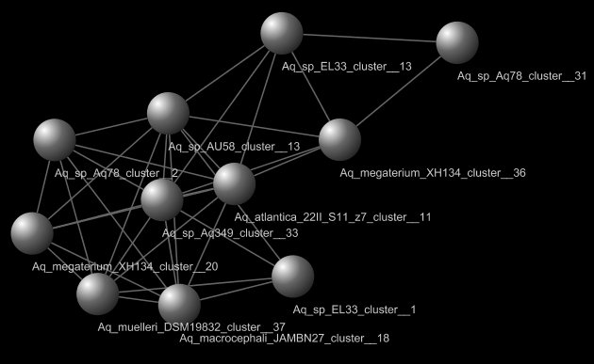
Cuniculene BGC
trans-AT PKS
Aq W01 cluster 18
Aq 135 cluster 24
Aq 78 cluster 26
Aq I324 cluster 31
Aq 349 cluster 28
Aq muelleri cluster 35
Aq atlantica cluster 16
Aq BL5 cluster 4
Aq macrocephali cluster 5
Aq amphilecti cluster 22
Aq 349 cluster 32
Aq 107 cluster 13
Aq AD1 cluster 9
Aq latercula cluster 14
Isolated biosynthetic intermediate
Aq megaterium cluster 25
Aq EL33 cluster 13
Notes:
46

Slide 47

Next steps
What is the coding potential within this genus?
Are the Aquimarina’s predicted secondary metabolites bioactive?
Task 2
Task 1
Comparative genomics approach
The Aquimarina genus
Task 3
Bioactivity assays
Task 4
Can we extract potential new drugs?
Are Aquimarina’s traits a common feature for the Flavobacteriaceae family?
Chemical identification and isolation of bioactive compounds
Metagenomics approach
Notes:
So, the work is divided into 4 main tasks.
Starting from a comparative genómics approach where we dissect Aquimarina genomes, we will go into testing bioactivities.
Beneficial or pathogenic relation with the hosts?
What is the ecological role of this species in the environments where they belong?
47

Slide 48
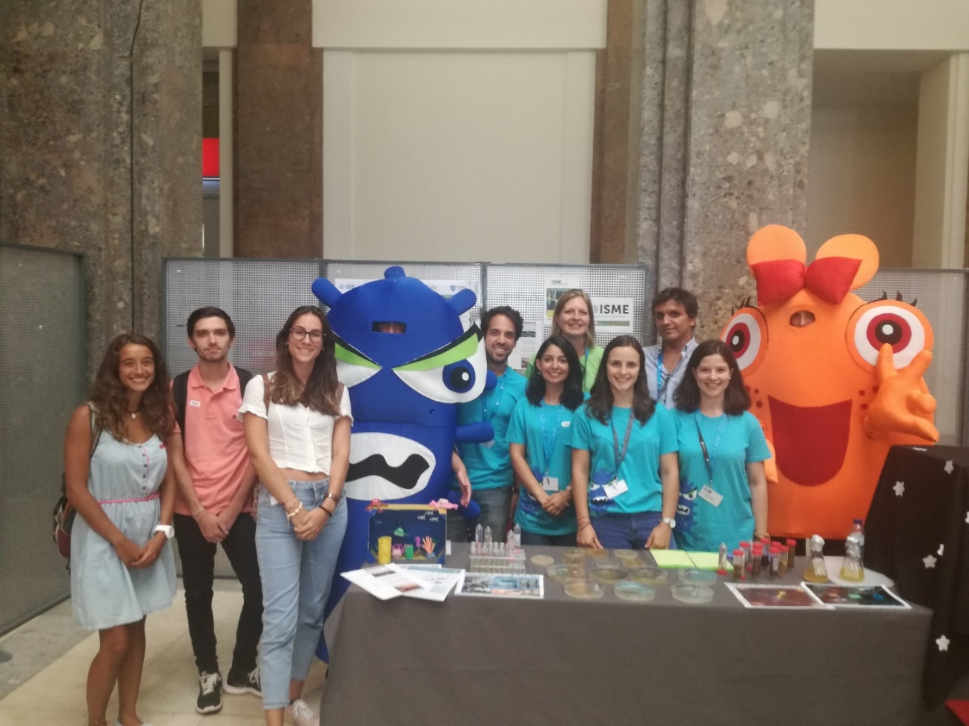

Acknowledgments
Special thanks to:
Prof. Dr. Rodrigo Costa
Dr. Tina Keller-Costa
Prof. Dr. Isabel Sá-Correia
Prof. Dr. Margarida Casal
Collaborators:
Patrícia Paula
Matilde Marques
Dr. Nuno Bernardes
Dr. Dalila Mil-Homens
Prof. Dr. Arsénio Fialho
Prof. Dr. Miguel Teixeira
Dr. Ulisses Nunes da Rocha (UFZ)
Prof. Dr. Jörn Piel (ETH Zurich)
MicroEcoEvo team
PD/BD/143029/2018
PTDC/MAR-BIO/1547/2014
PTDC/BIA-MIC/31996/2017
Project N.007317
UIDB/04565/2020
Notes:
48

Slide 49


Hands-on:
Bioinformatic tools for the identification of BGCs

Slide 50
antiSMASH
https://antismash.secondarymetabolites.org/
Web-based tool that allows the rapid genome-wide identification, annotation and analysis of secondary metabolite biosynthesis gene clusters in bacterial and fungal genomes.
It integrates and cross-links with many in silico secondary metabolite analysis tools and is powered by several open-source tools:
NCBI BLAST+
HMMer 3
Muscle 3
FastTree
PySVG
JQuery SVG.
Created in 2011
Current version: 5.0
antiSMASH 5.0: updates to the secondary metabolite genome mining pipeline. Kai Blin et al (2019) doi: 10.1093/nar/gkz310.
Notes:
Based on profile hidden Markov models of genes that are specific for certain types of gene clusters, antiSMASH is able to accurately identify the gene clusters encoding secondary metabolites of all known broad chemical classes.
antiSMASH not only detects the gene clusters, but also offers detailed sequence analysis.

Slide 51
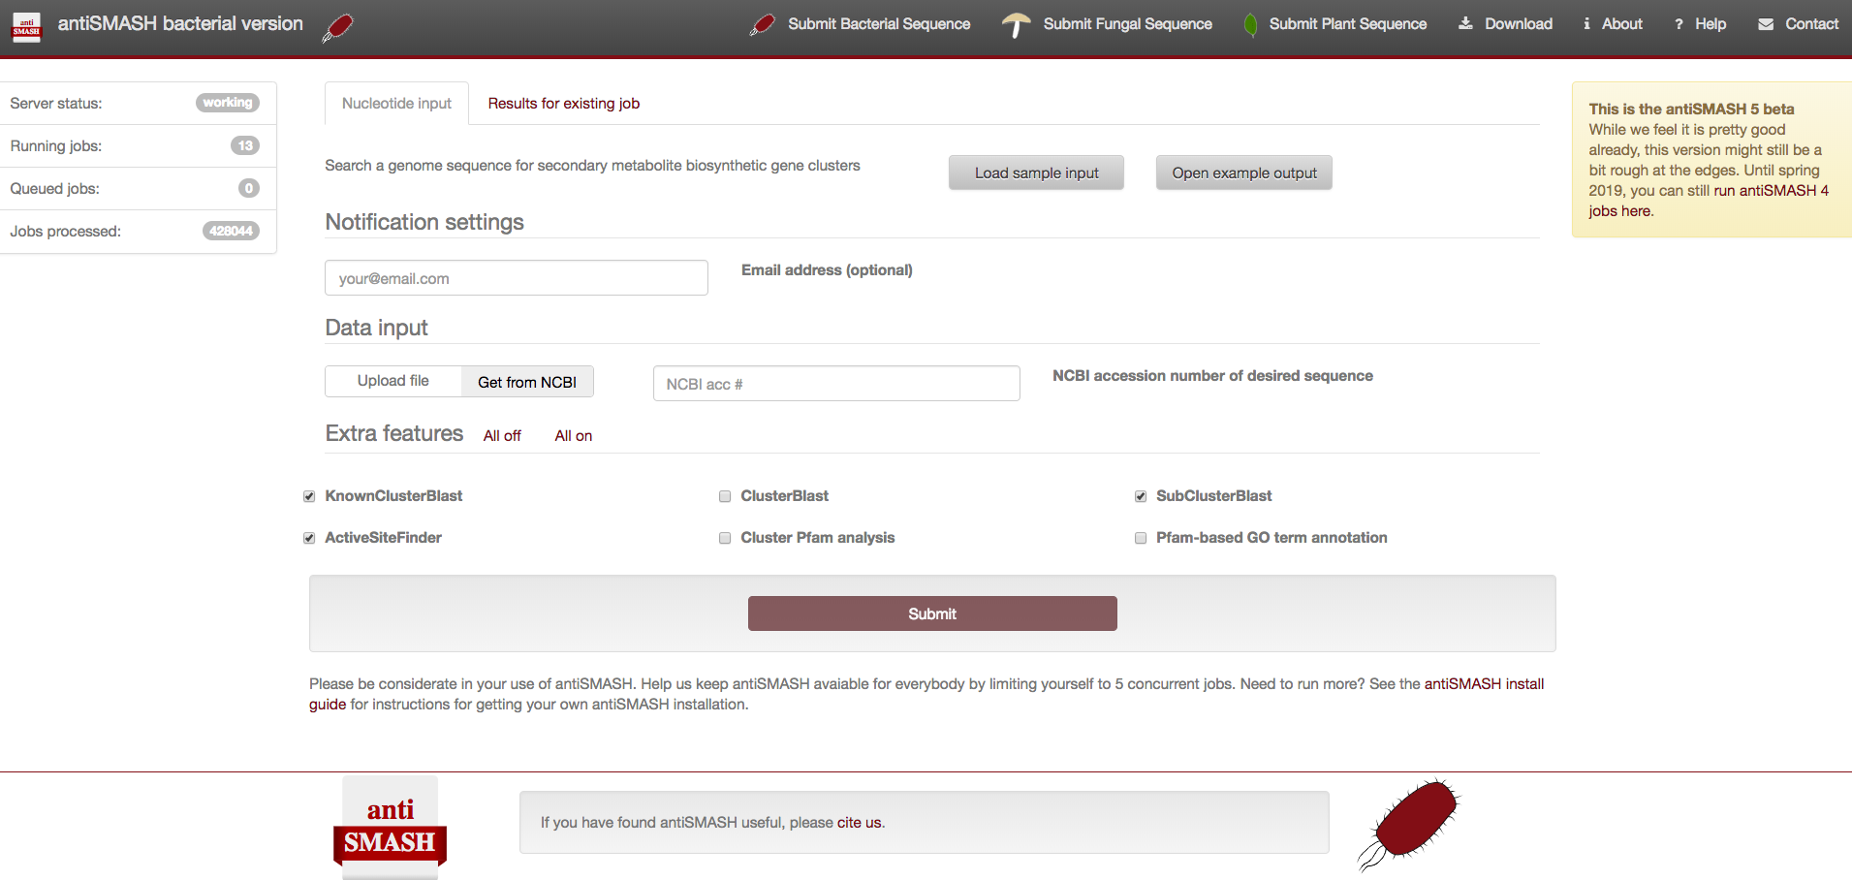
antiSMASH - Job submission page
Enter your email address (optional, but highly recommended: you get an email when your results have been processed).
Upload your sequence by using the “Upload file” button and selecting the sequence file (Fasta) to upload.
Select all extra features.
Notes:
To start an analysis,
Enter your email address (optional, but highly recommended: you get an email when your results have been processed).
and either
• Enter Genbank or RefSeq accession number to directly download sequence from NCBI
or
• Upload your sequence by using the “Upload file” button and selecting the sequence file (Fasta) to upload.
Select all extra features.

Slide 52
Now it’s your turn!
Practical exercise: submit your metagenome sequences into antiSMASH.
https://antismash.secondarymetabolites.org/
Notes:
antiSMASH can work with different formats of data. Data can be uploaded in Genbank (recommended), EMBL, or plain FASTA format.
The quality of the prediction by antiSMASH is highly dependent on the quality of the input data. If you analyze poor quality draft genomes with many (thousands) of small contigs and low N 50 , antiSMASH may not be able to detect gene clusters if they are scattered over multiple contigs.
Please be also aware, that many of the specificity determination algorithms in antiSMASH depend on the presence/absence of conserved amino acids at specific positions in the enzyme sequence. If the sequence quality is low and thus also the amino acid of the translated proteins cannot be fully trusted all predictions have to be taken with precautions.

Slide 53
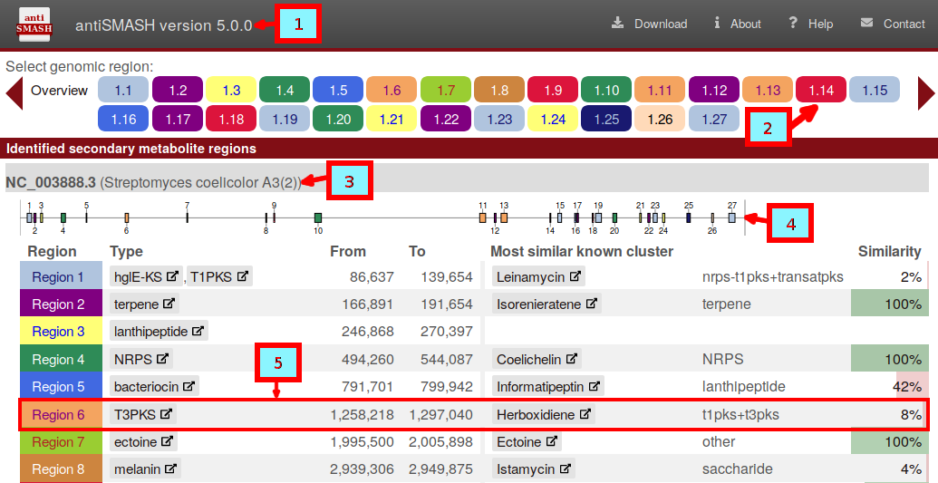
antiSMASH – The output

Slide 54
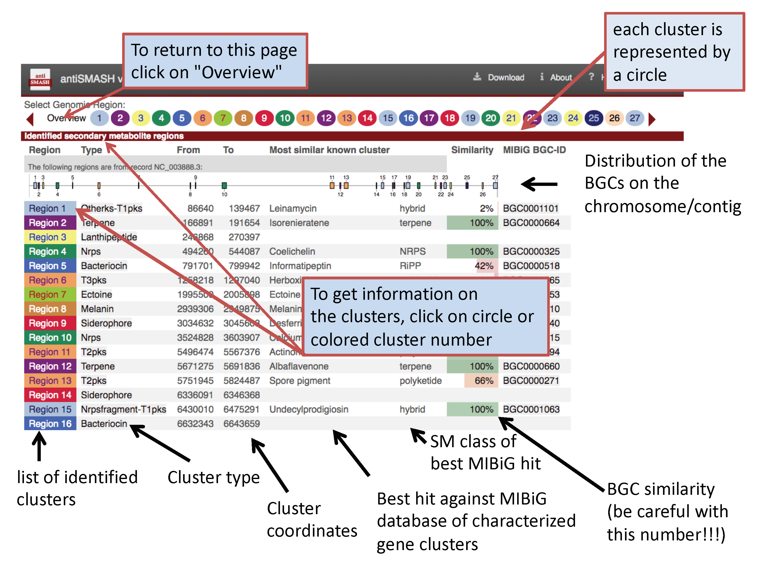
antiSMASH – The output

Slide 55
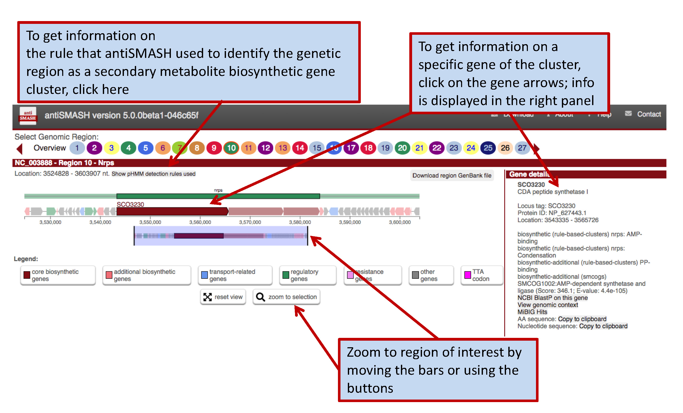
antiSMASH – The output
Notes:
To start an analysis, enter your email address (optional, but highly recommended → you get an email when your results have been processed) and either
• Enter Genbank or RefSeq accession number to directly download sequence from NCBI
or
• Upload your sequence by using the “Upload file” button and selecting the sequence file (Fasta) to upload

Slide 56
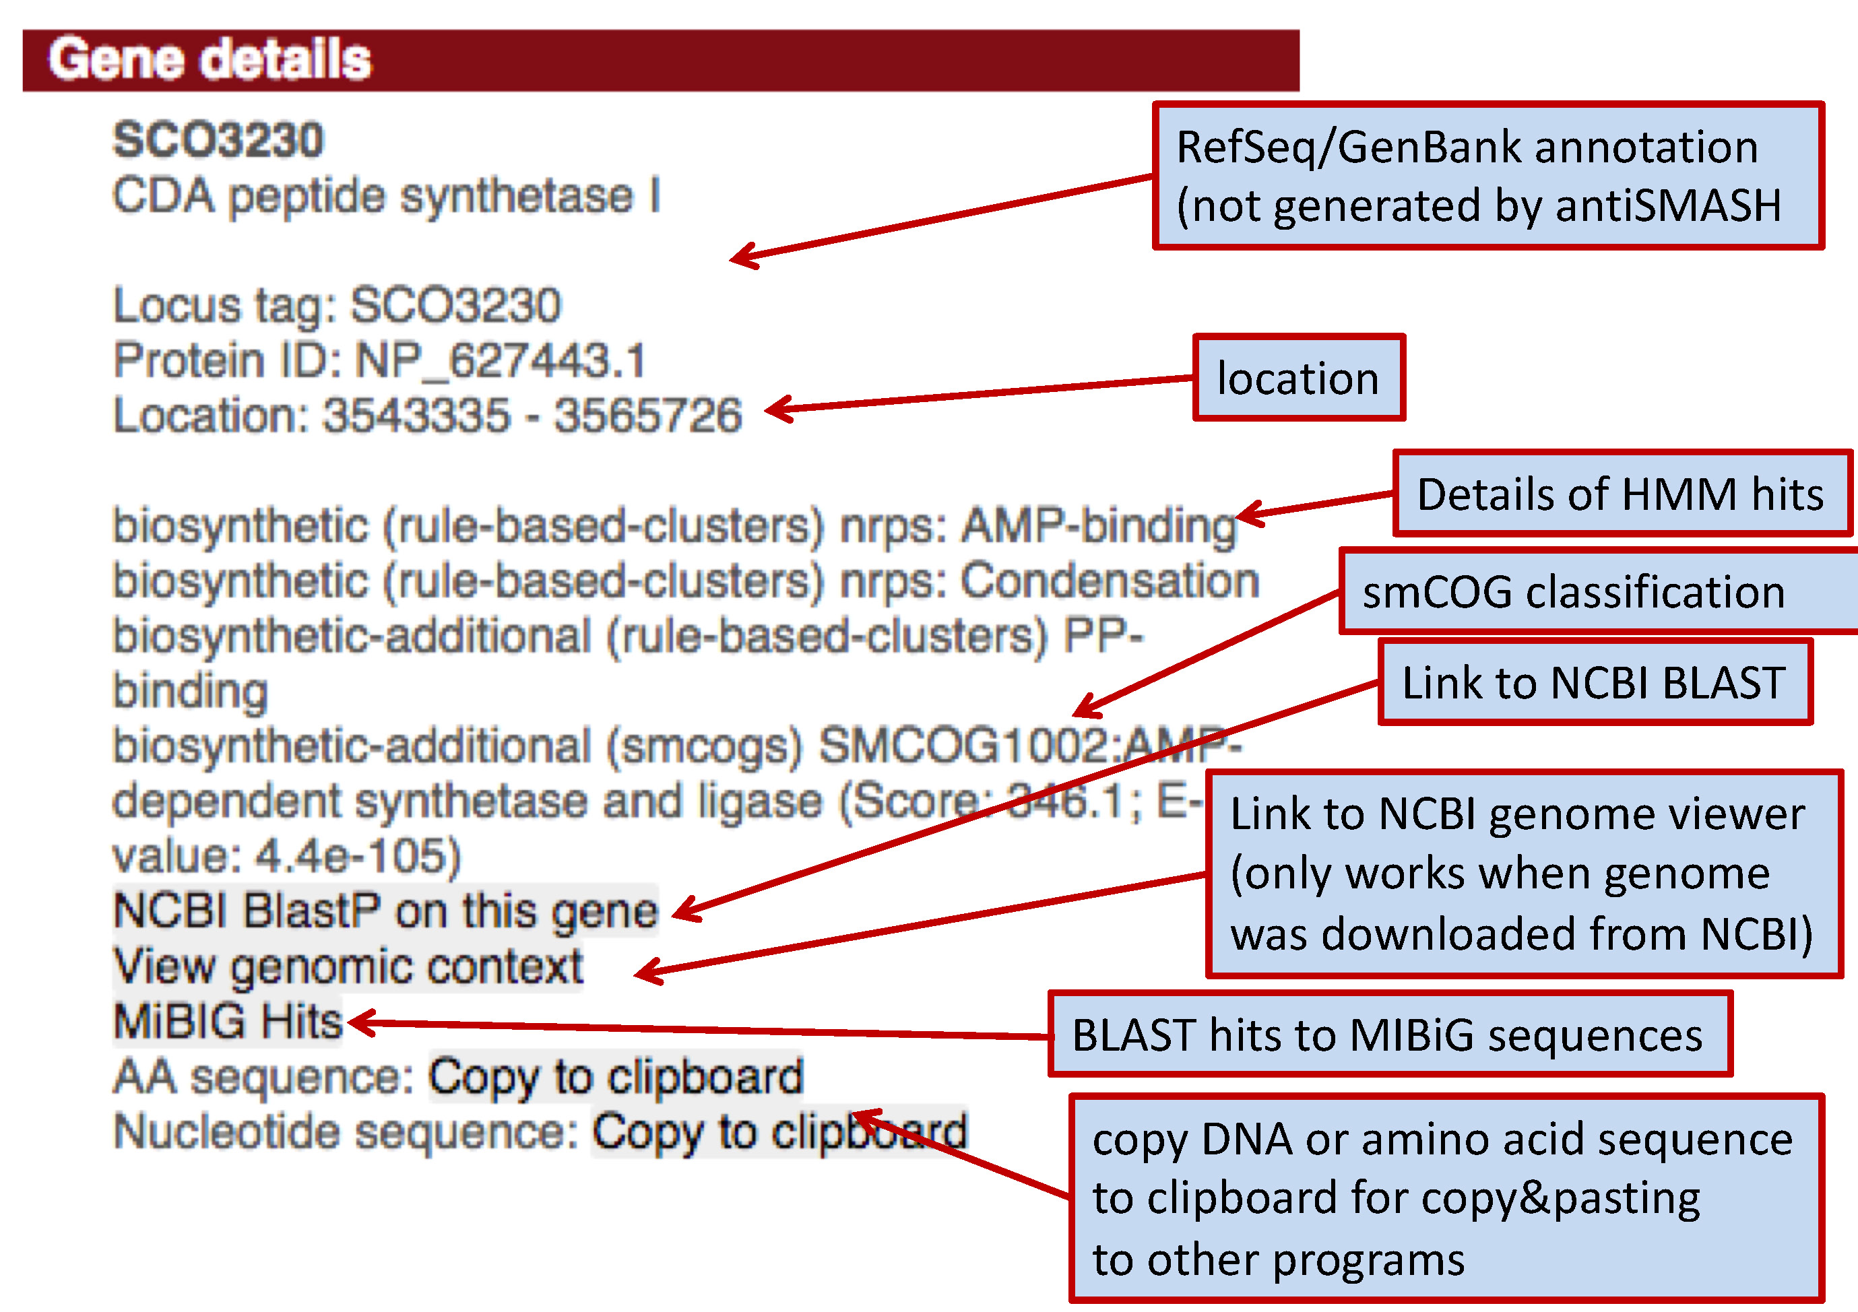
antiSMASH – The output
Notes:
Open:
antiSMASH homepage https://antismash.secondarymetabolites.org for bacterial sequences,
https://fungismash.secondarymetabolites.org for fungal
http://plantismash.secondarymetabolites.org/ for plant sequences
Select the correct type of antiSMASH analysis you want to carry out, as some of the functions are restricted (useful) for bacterial resp. fungal resp. plant sequences

Slide 57
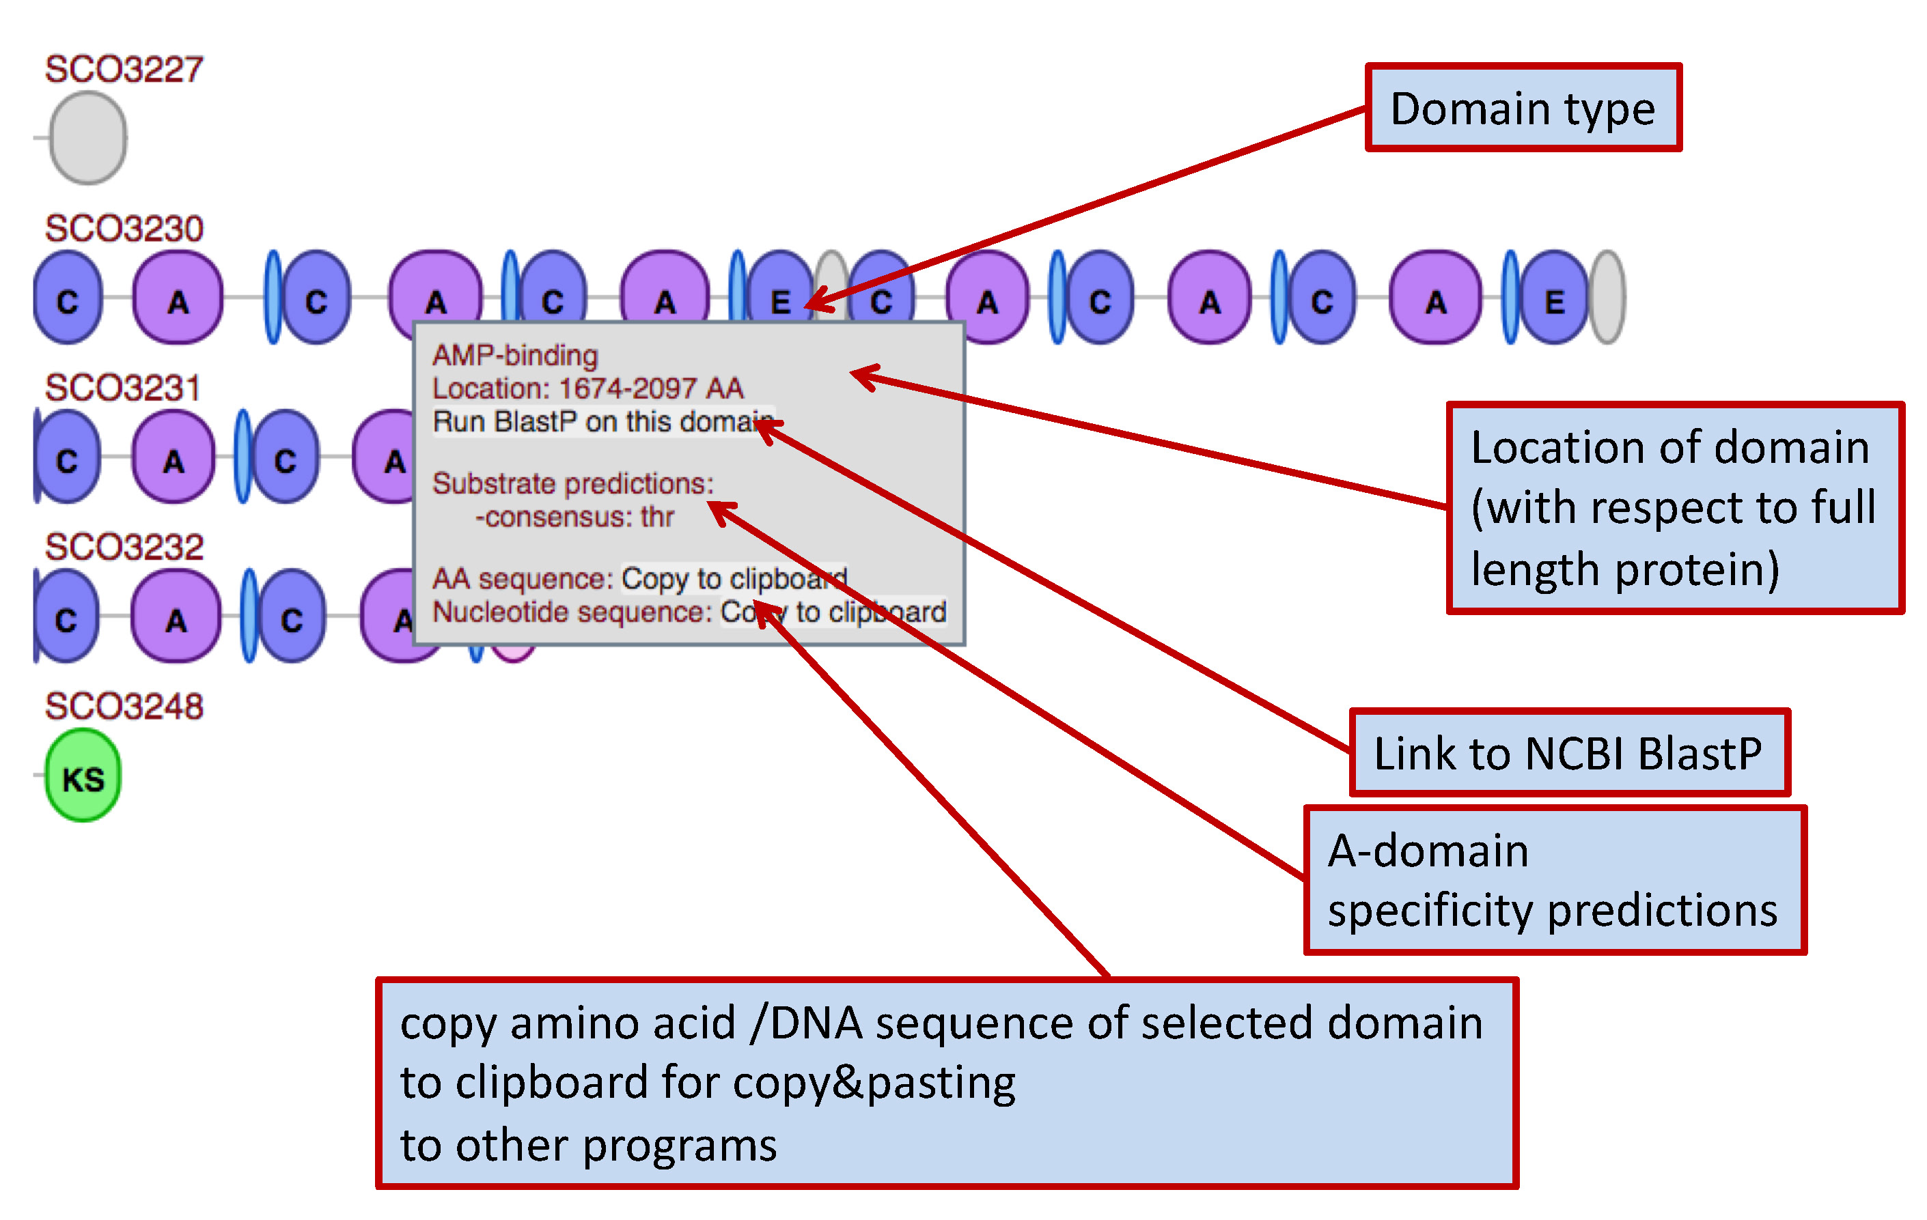
antiSMASH – The output
Notes:
KnownClusterBlast analysis (default: on): If this option is enabled, the identified clusters are searched against the MIBiG repository (13). MIBiG is a hand curated data collection on gene clusters, which have been experimentally characterized.
ClusterBlast analysis (default: off): If this option is enabled, the identified clusters are searched against a comprehensive gene cluster database and similar clusters are identified. (Selecting this option increases runtime significantly). The algorithm used is similar to MultiGeneBlast (14)
Subcluster Blast analysis (default: on): If this option is enabled, the identified clusters are searched against a database containing operons involved in the biosynthesis of common secondary metabolite building blocks (e.g. the biosynthesis of non-proteinogenic amino acids)
smCOG analysis for functional prediction and phylogenetic analysis of genes (always on): If this option is enabled, each gene of the cluster is compared to a database of clusters of orthologous groups of proteins involved in secondary metabolism. This information then is used to provide an annotation of the putative function of the gene products.
Active site finder (default: on): If this option is enabled, active sites of several highly conserved biosynthetic enzymes are detected and variations of the active sites are reported.
Detect TTA codons (always on for high GC genomes): Some high-GC bacteria, for example streptomycetes, use the rare Leu-codon “TTA” as a mean for post-transcriptional regulation by limiting/controlling the amount of TTA-tNRA in the cell. This type of regulation is commonly found in secondary metabolite BGCs. Selecting this option will annotate such TTA codons in the identified BGCs
Cluster PFAM analysis (default: off): If this option is enabled, each gene product encoded in the detected BGCs is analyzed against the PFAM database (15). Hits are annotated in the final Genbank/EMBL files that can be downloaded after the analysis is finished. Note: These 10An introduction to Genome Mining using antiSMASH results are not displayed on the antiSMASH HTML results page. Selecting this option normally increases the runtime.

Slide 58
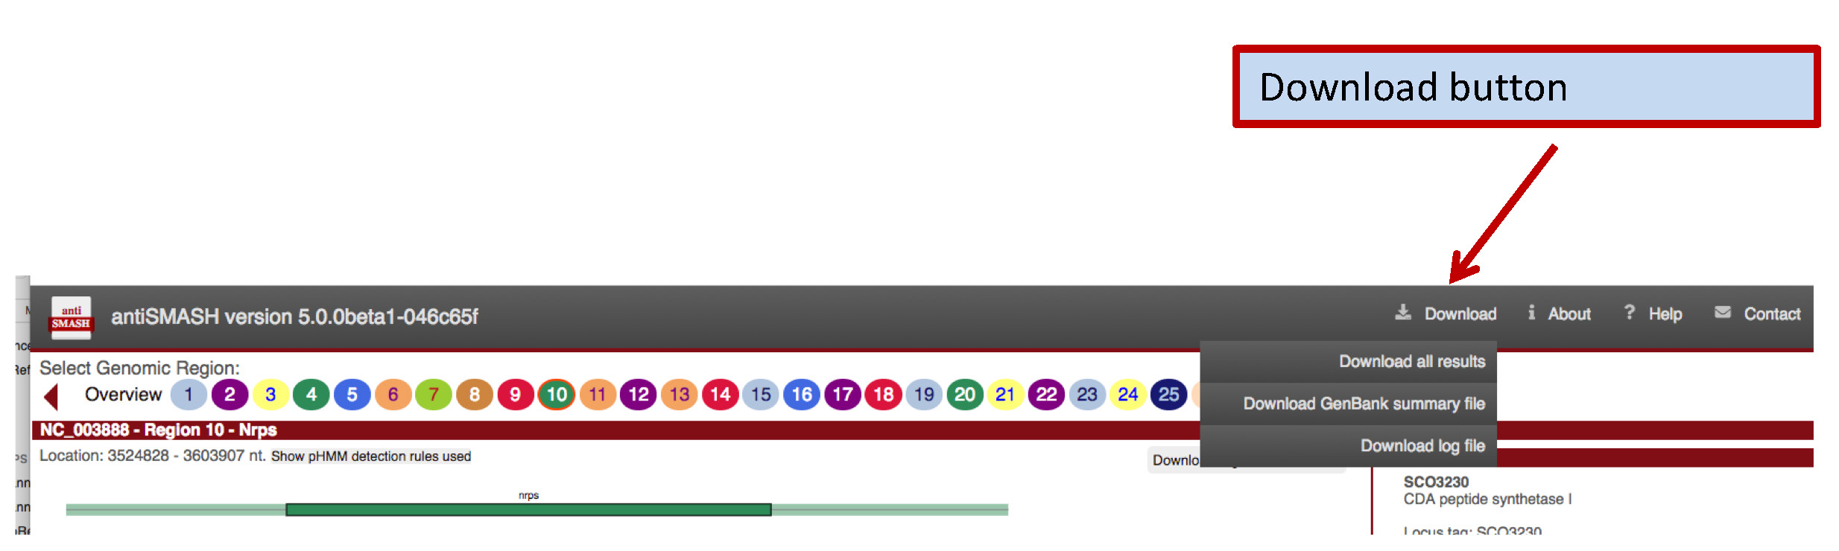
antiSMASH – The output
Notes:
KnownClusterBlast analysis (default: on): If this option is enabled, the identified clusters are searched against the MIBiG repository (13). MIBiG is a hand curated data collection on gene clusters, which have been experimentally characterized.
ClusterBlast analysis (default: off): If this option is enabled, the identified clusters are searched against a comprehensive gene cluster database and similar clusters are identified. (Selecting this option increases runtime significantly). The algorithm used is similar to MultiGeneBlast (14)
Subcluster Blast analysis (default: on): If this option is enabled, the identified clusters are searched against a database containing operons involved in the biosynthesis of common secondary metabolite building blocks (e.g. the biosynthesis of non-proteinogenic amino acids)
smCOG analysis for functional prediction and phylogenetic analysis of genes (always on): If this option is enabled, each gene of the cluster is compared to a database of clusters of orthologous groups of proteins involved in secondary metabolism. This information then is used to provide an annotation of the putative function of the gene products.
Active site finder (default: on): If this option is enabled, active sites of several highly conserved biosynthetic enzymes are detected and variations of the active sites are reported.
Detect TTA codons (always on for high GC genomes): Some high-GC bacteria, for example streptomycetes, use the rare Leu-codon “TTA” as a mean for post-transcriptional regulation by limiting/controlling the amount of TTA-tNRA in the cell. This type of regulation is commonly found in secondary metabolite BGCs. Selecting this option will annotate such TTA codons in the identified BGCs
Cluster PFAM analysis (default: off): If this option is enabled, each gene product encoded in the detected BGCs is analyzed against the PFAM database (15). Hits are annotated in the final Genbank/EMBL files that can be downloaded after the analysis is finished. Note: These 10An introduction to Genome Mining using antiSMASH results are not displayed on the antiSMASH HTML results page. Selecting this option normally increases the runtime.

Slide 59
Result obtained for the Aquimarina study:
Silva, SG., Blom, J., Keller-Costa, T, Costa, R. 2019 Environmental Microbiology
Notes:
High number of NRPSs
And polyketide synthases
59

Slide 60
Another example:
Potential for Secondary Metabolite Synthesis in Soft Coral-Associated Bacteria
Bacterial isolates
Number of BGCs per Genome
440 biosynthetic gene clusters (BGCs) on the genomes of 15 bacterial associates (12 genera) isolated from the soft corals Eunicella labiata and Eunicella verrucosa.
Raimundo, I, Silva, SG., Costa, R & Keller-Costa, T 2018 Marine Drugs
Notes:
To have an idea of this potential, we recently performed
a comparative genomcs approach of the genomes of 15 bacterial isolates from the gorgonian coral Eunicella labiata
Where you can see a huge biosynthetic potential.
We were specially intrigued by a particular genus, the Aquimarina genus
Polyketides: structurally complex & diverse secondary metabolites (examples: Erythromycin, Tetracyclines, Avermectin)
60

Slide 61
BiG-SCAPE
Biosynthetic Gene Similarity Clustering and Prospecting Engine
BiG-SCAPE is a tool that calculates distances between BGCs in order to map the BGC diversity onto sequence similarity networks, which are then processed for automated reconstruction of Gene Cluster Families
Groups of gene clusters that encode biosynthesis of highly similar or identical molecules.
BiG-SCAPE's interactive visualizations of these similarity networks allows effective exploration of the diversity of BGCs, linking them to knowledge from reference data within the MIBiG repository
https://git.wageningenur.nl/medema-group/BiG-SCAPE
Navarro-Muñoz, J.C. et al. A computational framework to explore large-scale biosynthetic diversity. Nat Chem Biol 16, 60–68 (2020).

Slide 62
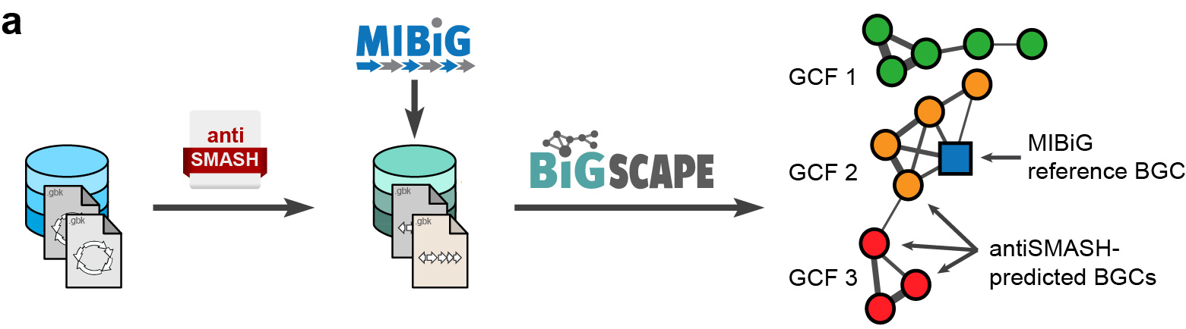
The BiG-SCAPE workflow uses sequence similarity networking to group biosynthetic gene clusters into families
Input: results from antiSMASH
Output: graphical visualization of similarity networks

Slide 63
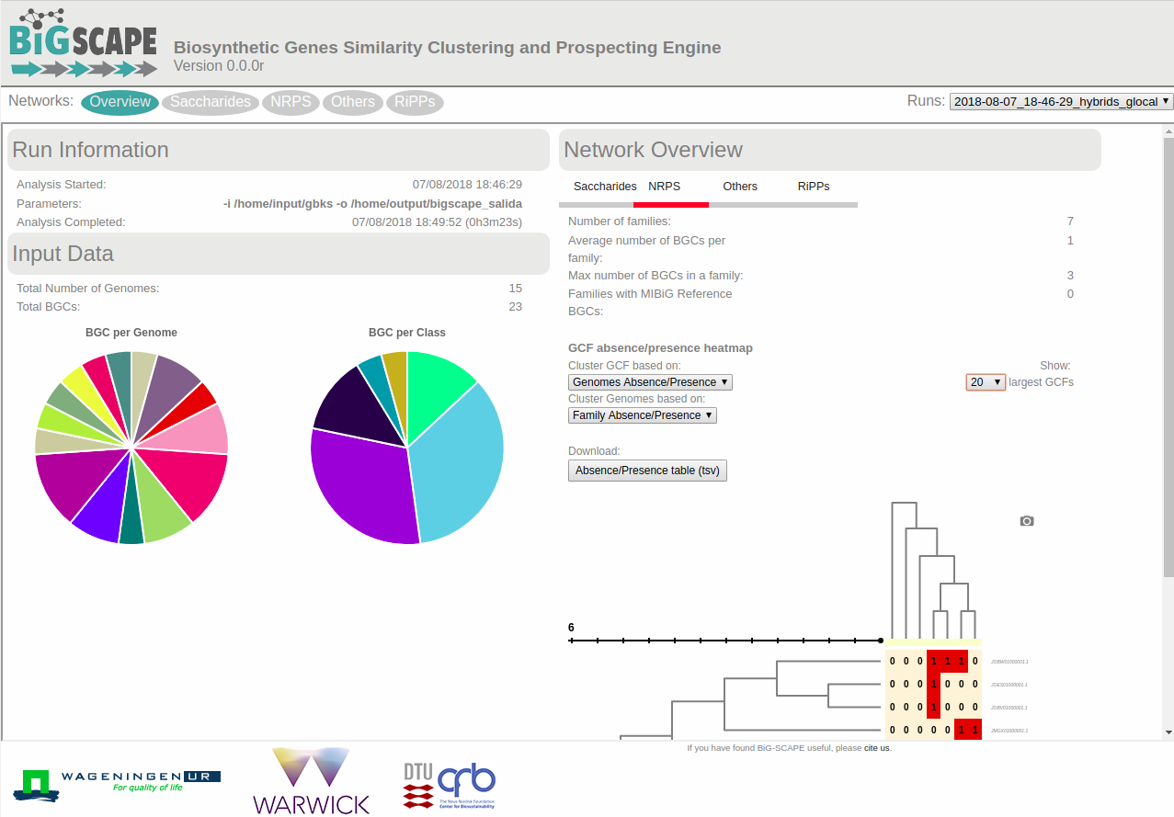
BiG-SCAPE – The output

Slide 64
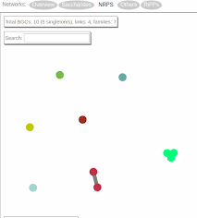
BiG-SCAPE – The output
The distances for each cutoff value will be used to automatically define 'Gene Cluster Families' (GCFs) for each compound class.

Slide 65
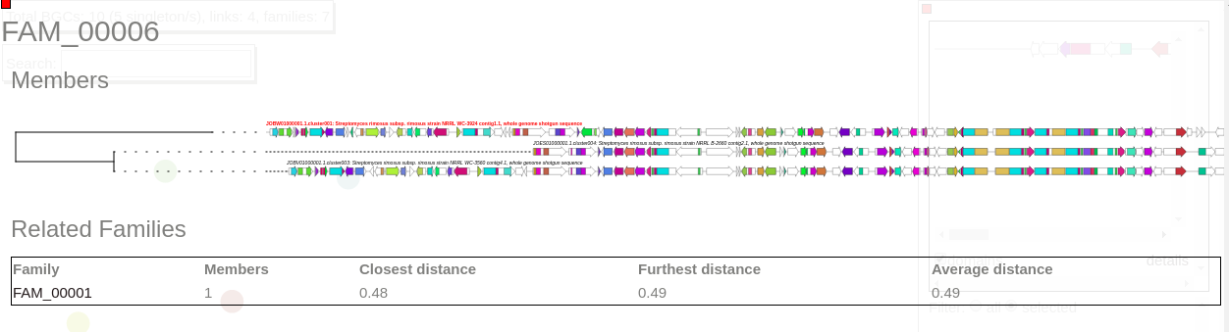
BiG-SCAPE – The output
Gene Cluster Family (GCF) example:

Slide 66
Result obtained for the Aquimarina study:
439
Gene Cluster Families
Notes:
The Aquimarina genus possesses a vast potential to synthesize a large variety of secondary metabolites
66

Slide 67
What you’ll need to apply the BiG-SCAPE workflow to your antiSMASH results:
1) Once the antiSMASH run is finished, you'll receive an email. Open the link provided.
2) On the top of "overview" page", you will find the option "Download all results". Click on it. A zip folder will be downloaded. Unzip it.
3) On each antiSMASH results folder you will find several different files in different formats. For the BiG-SCAPE workflow you will need the GenBank (.gbk) files corresponding to each BGC identified.
For later identification, the filename of each gbk file must be renamed so that you later know from which genome each BGC came from.
Example of a suitable filename : Aq_Aq78_contig_1.region001.gbk
Make sure that you don't have any spaces in the filename.
4) Move all the gbk files into a single folder. Zip the folder to make the file transfer easier.
5) Send this zipped folder to: sandragodinhosilva@gmail.com
I'll run the BiG-SCAPE pipeline and return the results to you as soon as possible.

Slide 68
If you want to run BiG-SCAPE on your own:
1) Unfortunately, this workflow needs to be run on a Linux operating system. As most of us have a Windows operating system on our computers, this might be the major difficulty.
2) If that isn't a problem for you, you can try to install BiG-SCAPE. All the instructions to do so are available in the following link:
https://git.wageningenur.nl/medema-group/BiG-SCAPE/-/wikis/installation
3) Please talk with me and I'll be happy to help you on this process.

Slide 69
Thank you for your attention.
Sandra Godinho Silva
sandragodinhosilva@tecnico.ulisboa.pt

